Slide 1
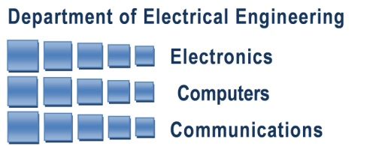

Xampling
Analog-to-digital at Sub-Nyquist rates
Yonina Eldar
Department of Electrical Engineering
Technion – Israel Institute of Technology
http://www.ee.technion.ac.il/people/YoninaEldar/ yonina@ee.technion.ac.il
ISIT Tutorial
July 31st, 2011
Notes:
Have a dream come true

Slide 2
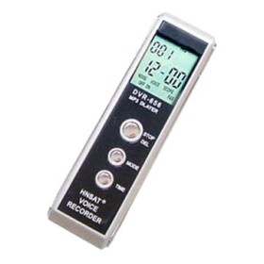
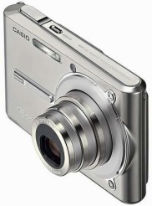
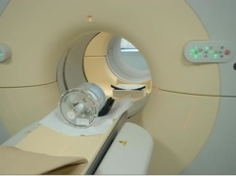
“Analog Girl in a Digital World…”
Judy Gorman `99
Digital domain
Analog
signal
Analog
signal
Compress
~1:10
De-
Compress
ADC
DAC
Nyquist rate
Voice recorder
Camera
Medical imaging
“Can we not just directly measure the part that will not end up being thrown away ?”
Donoho, ‘06

Slide 3
Key Idea
Exploit structure to improve data processing performance:
Reduce storage/reduce sampling rates
Reduce processing rates
Increase imaging resolution
Reduce power, size, cost…
Goal:
Survey sampling strategies that exploit signal structure to reduce rate
Present a unified framework for sub-Nyquist sampling
Provide a variety of different applications and benefits

Slide 4
Outline
Part 1: Introduction
Part 2: Sub-Nyquist in a subspace
  Generalized sampling framework
  Examples
Part 3: Union of subspaces
  Model, analog and discrete applications
  Short intro to compressed sensing
Part 4: Xampling, Sub-Nyquist in a union
  Functional framework
  Modulated wideband conversion
  Sparse shift-invariant sampling
  Finite-rate/sequences of innovation methods
  Random demodulation
Part 5: From theory to hardware
  Practical design metrics
  Circuit challenges

Slide 5







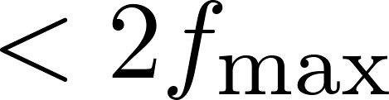
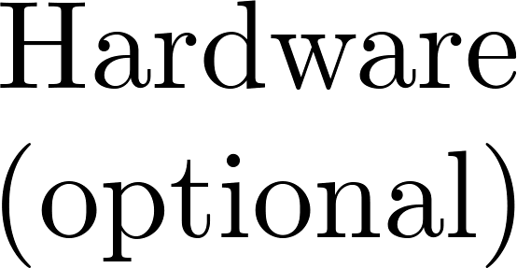

Outline Schematically
Definition: Nyquist-rate system
A single ADC device outputs a stream of numbers at rate
High-rate
Sub-Nyquist system
  One or more ADC devices
  Each ADC device runs at a rate below
  With / without analog preprocessing
Overall rate
← Our main focus
Low-rate
Notes:
5

Slide 6
Tutorial Goal
To be as interactive as possible!
Feel free to ask questions
Raise ideas
Slow me down if things are too fast …
Hope you learn and enjoy!

Slide 7
– Part 1 –
Introduction
→ Outline

Slide 8



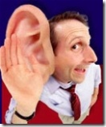
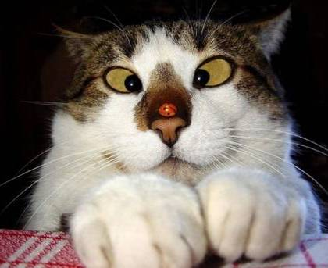
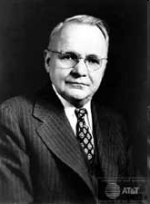
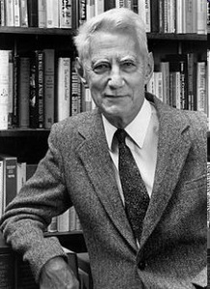
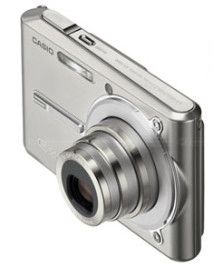
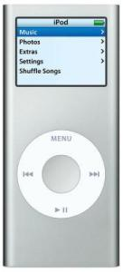
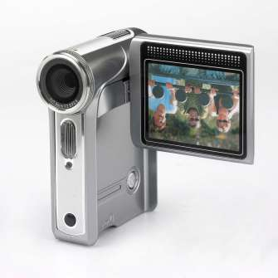
Sampling: “Analog Girl in a Digital World…” Judy Gorman 99
Analog world
Digital world
Sampling
A2D
Signal processing
Image denoising
Analysis…
Reconstruction
D2A
Music
Radar
Image…
Very high sampling rates:
hardware excessive solutions
High DSP rates
(Interpolation)

Slide 9
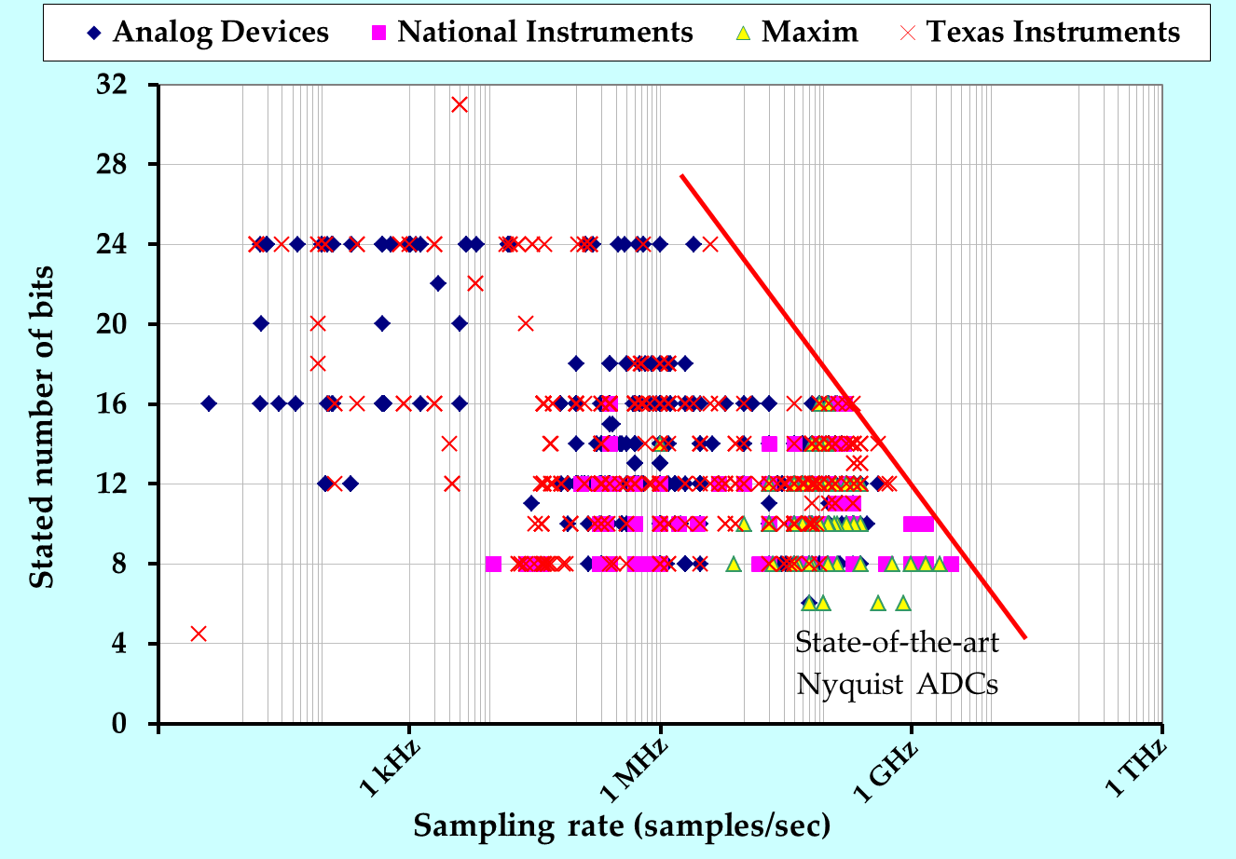
ADC Market
State-of-the-art ADCs generate uniform samples at the input’s Nyquist rate
Continuous effort to:
  increase sampling rate (Giga-samples/sec)
  increase front-end bandwidth
  increase (effective) number of bits
Working in digital becomes difficult

Slide 10

Nyquist Rate Sampling
Standard processing techniques require sampling at the Nyquist rate = twice the highest frequency
Narrow pulse, wide sensing range = high Nyquist rate
Results in hardware excessive solutions and high DSP rates
Too difficult to process, store and transmit
Main Idea:
Exploit structure to reduce sampling and processing rates

Slide 11


The Key – Structure
Sampling
A2D
Uncountable
Countable
Sampling reduces ``dimenions’’
Must have some prior on
Model too narrow (e.g. pure sine) → not widely applicable
Model too wide (e.g. bandlimited) → no rate reduction
piece-wise linear
bandlimited
Key: Treat signal models that are sufficiently wide and structured at the same time
Prior (= Signal Model) Necessary for Recovery

Slide 12
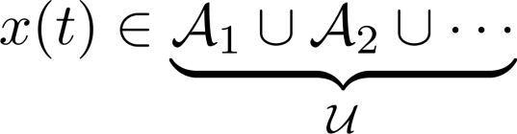







Structure Types
In this tutorial we treat 2 main structures:
Subspace
Union of subspaces
Linear:
Nonlinear:
Generalized sampling theory
Xampling (functional framework)
Subspace modeling is used in many practical applications
BUT, can result in unnecessary-high sampling and processing rates
Union modeling paves the way to innovative sampling methods,
at rates as low as the actual information rate

Slide 13



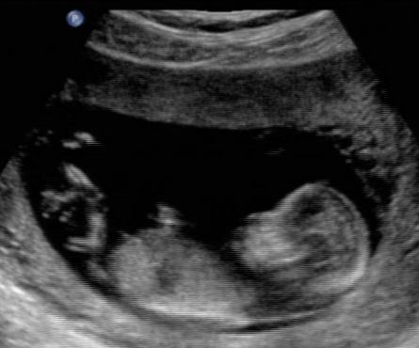




Ultrasound
High sampling rates
High digital processing rates
Tx pulse
Ultrasonic probe
Rx signal
Unknowns
Echoes result from scattering in the tissue
The image is formed by identifying the scatterers

Slide 14
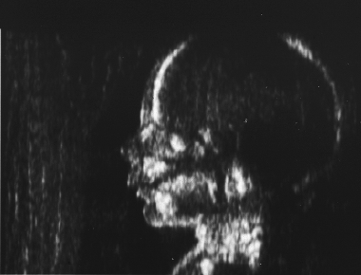
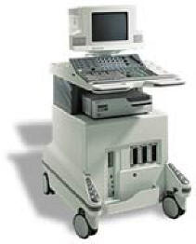
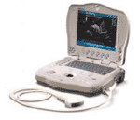
Processing Rates
To increase SNR the reflections are viewed by an antenna array
SNR is improved through beamforming by introducing appropriate time shifts to the received signals
Requires high sampling rates and large data processing rates
Subspace: One image trace requires 128 samplers @ 20M, beamforming to 150 points, a total of 6.3x10⁶ sums/frame
Union: can reduce sampling rate by orders of magnitude
Focusing the received
beam by applying delays
Xdcr
Scan Plane
Goal: reduce ultrasound machines to a size of a laptop at same resolution
Portable
Systems
Low-End
Systems
High-End
Systems

Slide 15
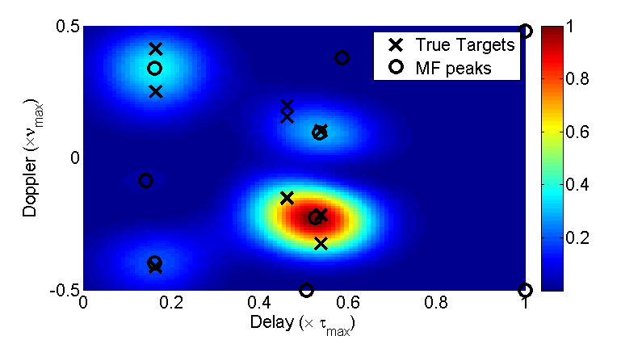
Resolution (1): Radar
Principle:
  A known pulse is transmitted
  Reflections from targets are received
  Target’s ranges and velocities are identified
Challenge:
  All processing is done digitally
  Targets can lie on an arbitrary grid
  Process of digitizing
  → loss of resolution in range-velocity domain
Subspace methods:

Slide 16
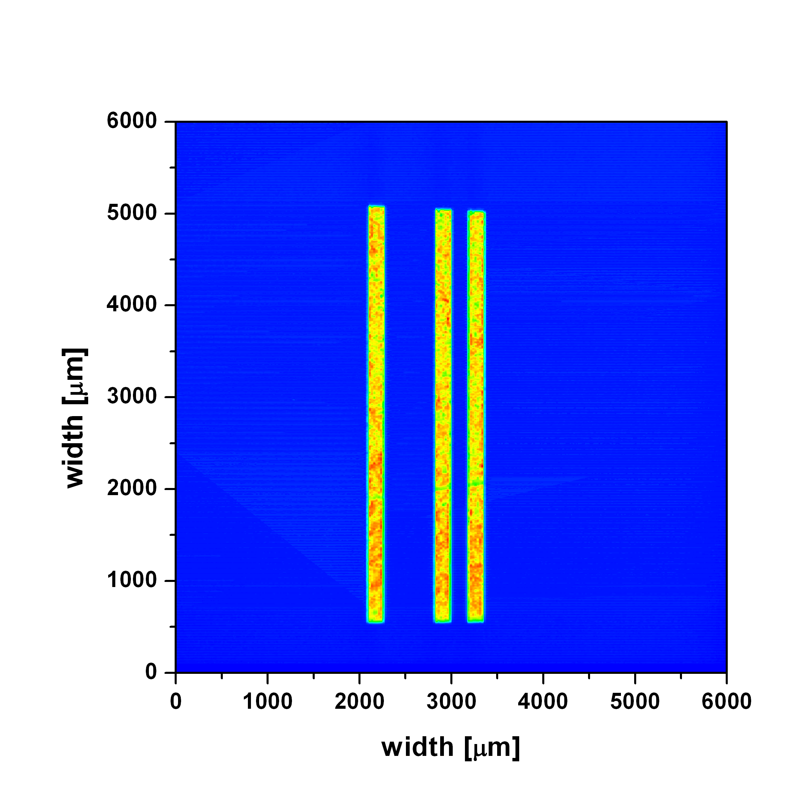
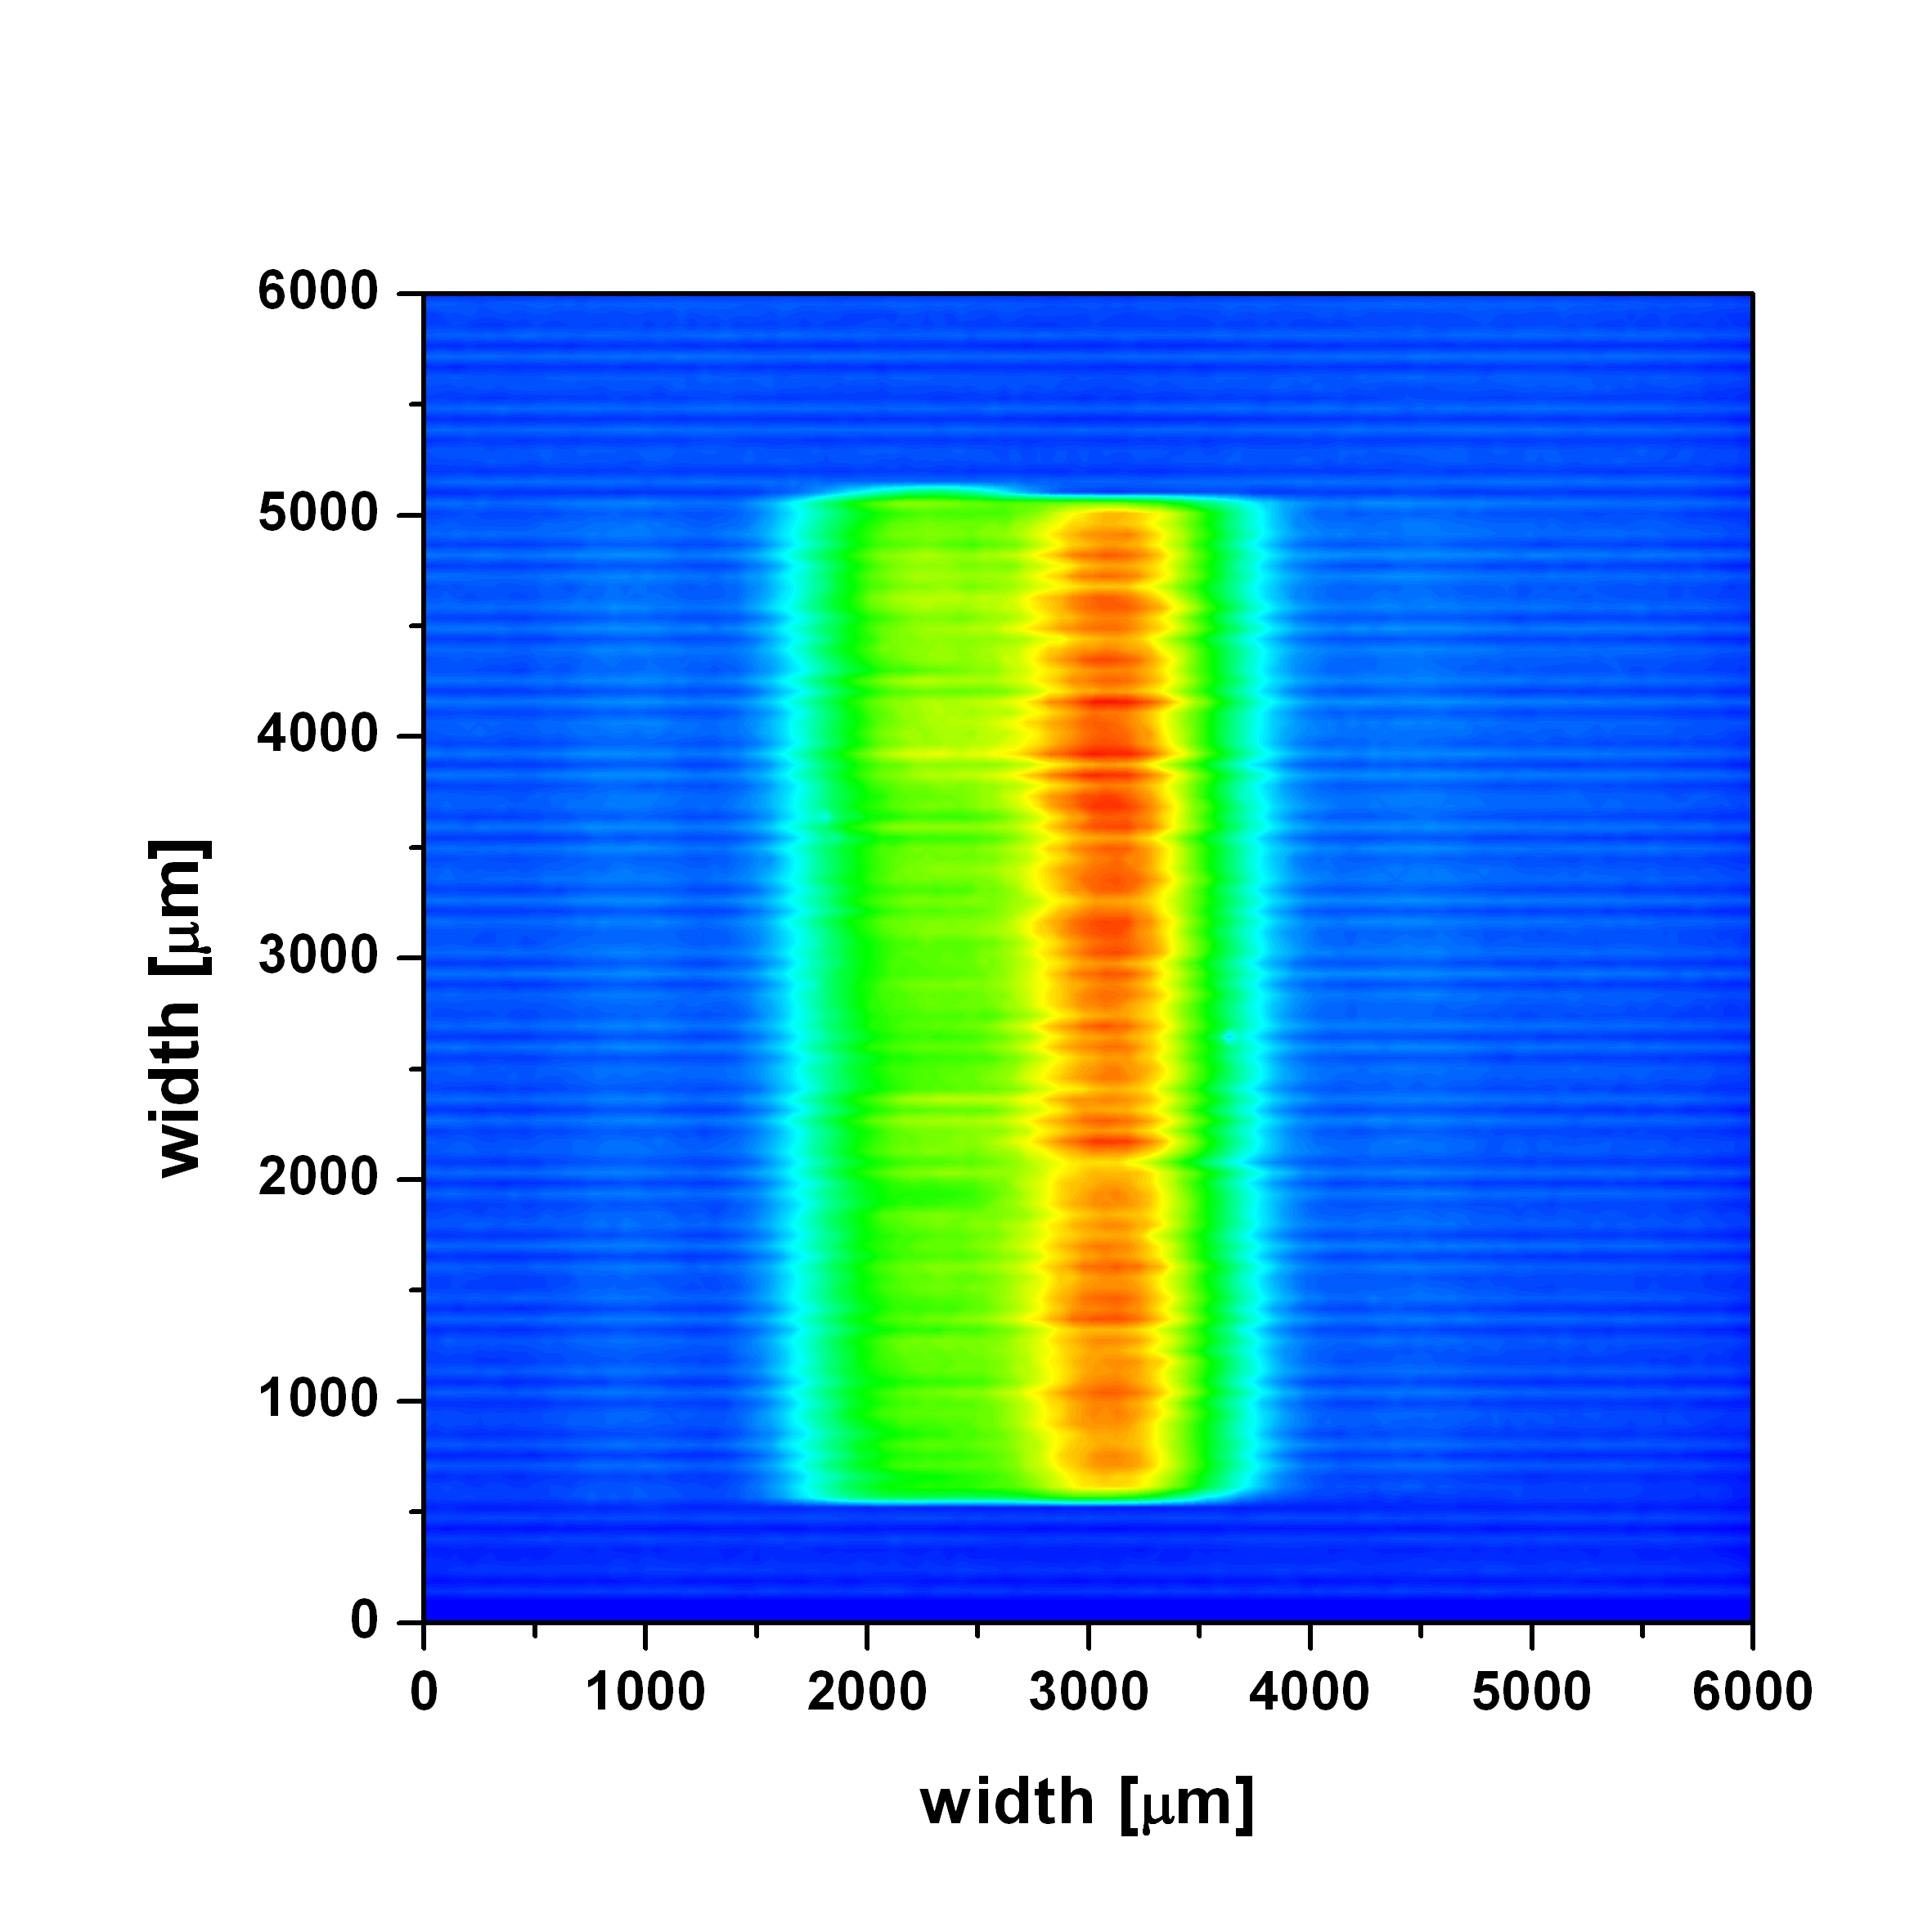
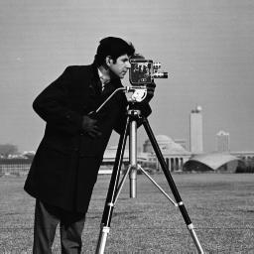
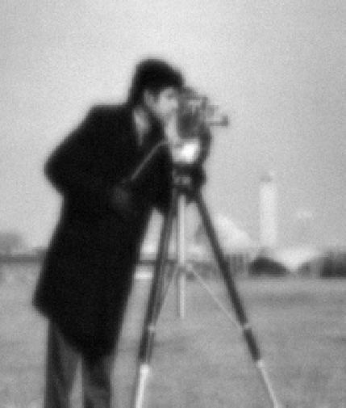
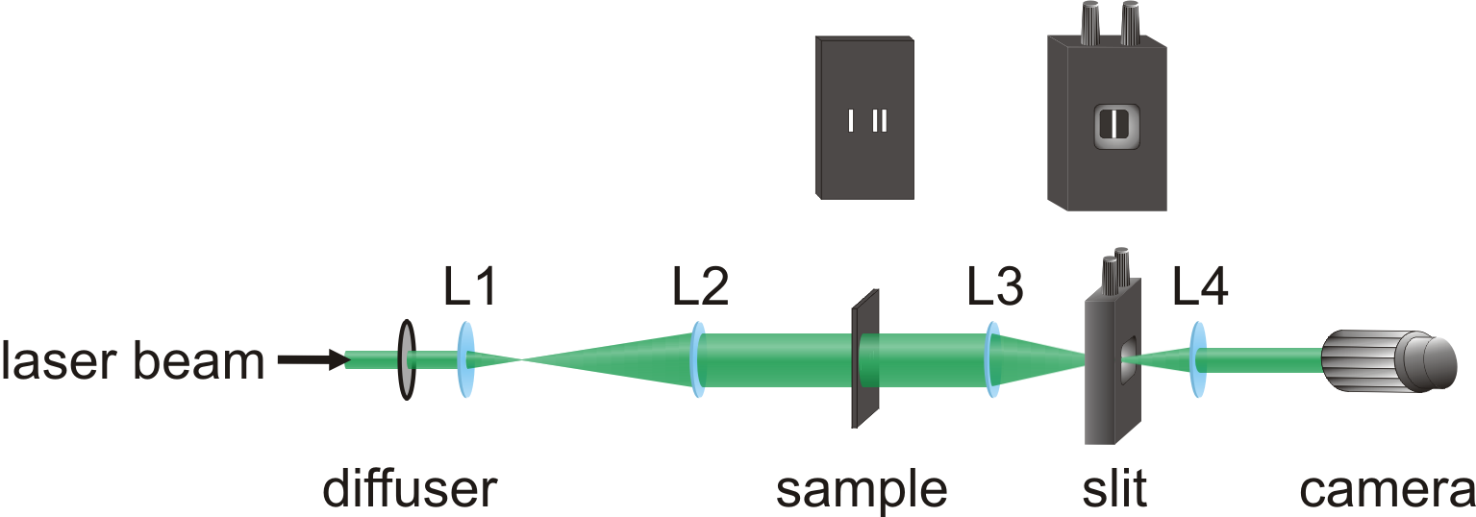
Resolution (2): Subwavelength Imaging
Diffraction limit: Even a perfect optical imaging system has a resolution limit determined by the wavelength λ
  The smallest observable detail is larger than ~ λ/2
  This results in image smearing
Subspace methods:
Input
Output

Slide 17
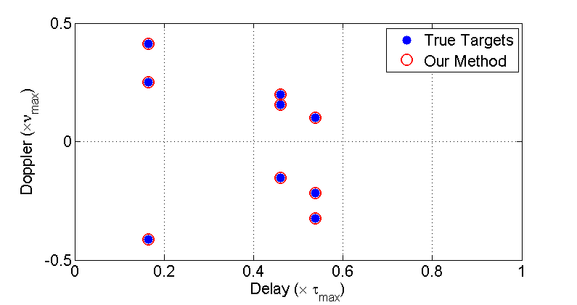


Imaging via Union Modeling
Radar:
Union method
Subwavelength:
Bajwa et al., ‘11
150 nm
Gazit et al., ‘11

Slide 18


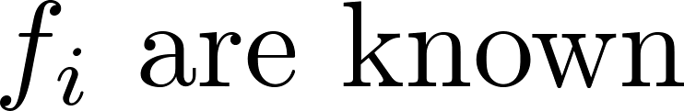

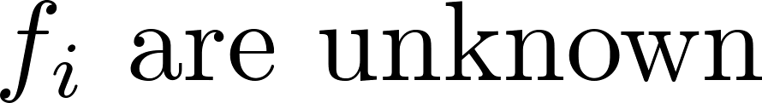
Wideband Communication
AM
FM
QAM
QPSK
Subspace methods:
  RF demodulation
  Undersampling
  and more…
Unknown , e.g. cognitive radio. Should we sample at ?
Union modeling:
  Can sample at the actual information bandwidth, even though
  Can process at low rate (no need to reconstruct Nyquist-rate samples)

Slide 19
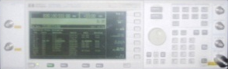
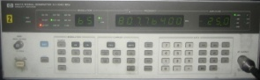
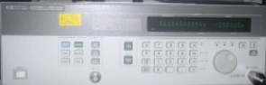
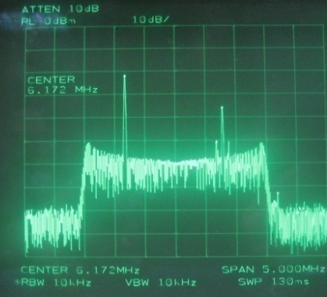
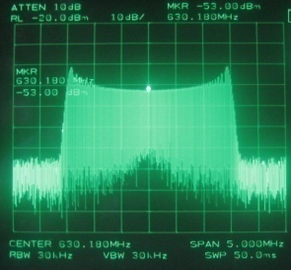
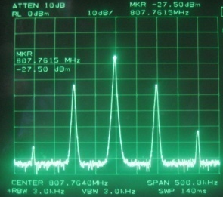
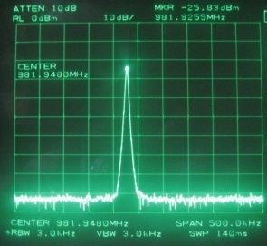
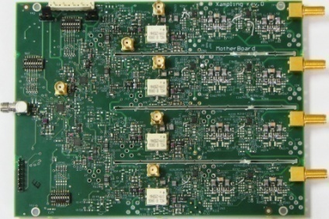
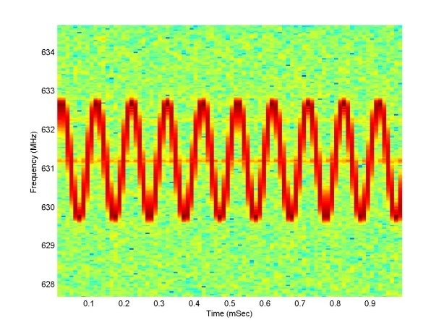
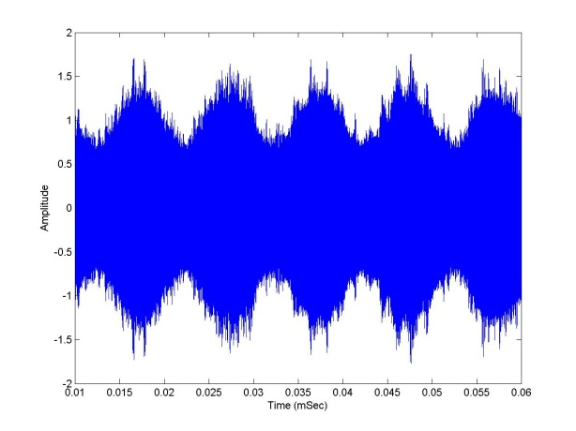
Sub-Nyquist Demonstration
Carrier frequencies are chosen to create overlayed aliasing at baseband
+
+
Overlayed sub-Nyquist
aliasing around 6.171 MHz
FM @ 631.2 MHz
AM @ 807.8 MHz
Sine @ 981.9 MHz
MWC prototype
10 kHz
100 kHz
Reconstruction
(CTF)
1.5 MHz
FM @ 631.2 MHz
AM @ 807.8 MHz
Mishali et al., ‘10

Slide 20







Xampling
High-rate
Low-rate
HW
SW
Main idea:
  Move compression before ADC
  Use nonlinear algorithms to interface with standard DSP and signal reconstruction

Slide 21
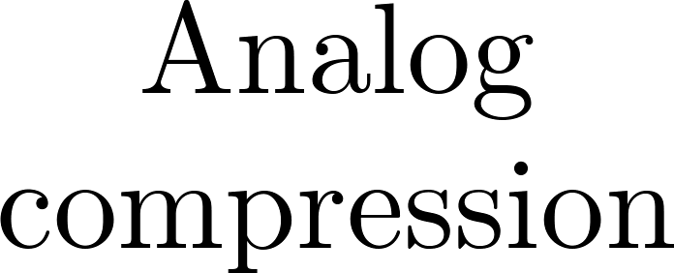
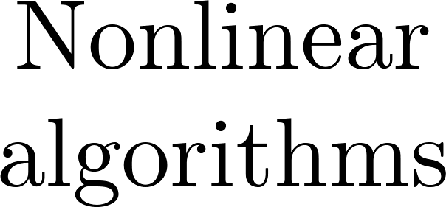
Xampling
New hardware designs
New digital algorithms
HW
SW
Main idea:
  Move compression before ADC
  Use nonlinear algorithms to interface with standard DSP and signal reconstruction
Follow a set of design principles → step from theory to hardware

Slide 22
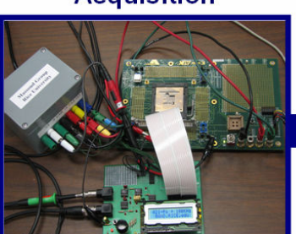
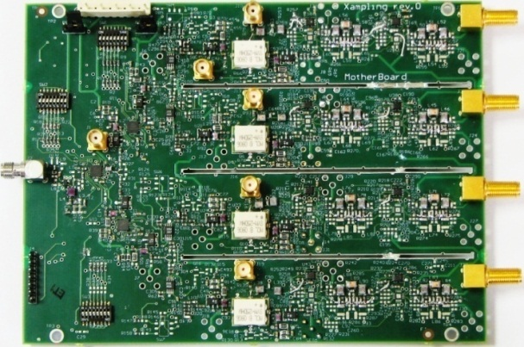
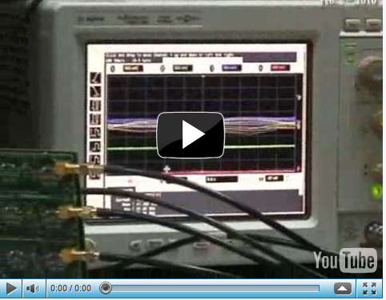
From Theory to Hardware
2.4 GHz Nyquist-rate, 120 MHz occupancy
280 MHz sampling rate
49 dB dynamic range
SNDR > 30 dB over input range
800 kHz Nyquist-rate
100 kHz sampling rate
Ragheb et al., 08
Mishali et al., 10
Candès et al., 08
Emami et al., 08
RICE 1-pixel camera
DARPA A2I Project
See many more contributors in compressive sensing hardware
Tutorial briefly covers circuit challenges in sub-Nyquist systems
Sub-Nyquist technology becomes feasible !

Slide 23
Tutorial Goal
Instead of a single subspace modeling use union of subspaces framework
Adopt a new design methodology – Xampling
Result: Simple hardware and low computational cost on the DSP
  Compression+Sampling = Xampling
X prefix for compression, e.g. DivX
Theory, Algorithms, Hardware
What’s next:
Part 2: Sub-Nyquist in a subspace
Parts 3-5: Sub-Nyquist in union models
Notes:
This slide should appear after the current 18 (i.e. write before part II).

Slide 24
– Part 2 –
Sub-Nyquist in a Subspace
→ Outline

Slide 25
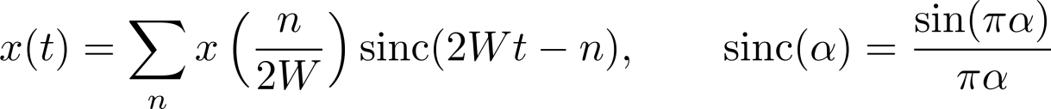





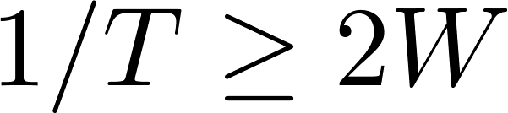

Shannon-Nyquist Sampling
Theorem [Bandlimited Sampling]
Shannon, ‘49
Model: Bandlimited signals
Sampling: Pointwise at rate
Reconstruction: Interpolation by

Slide 26
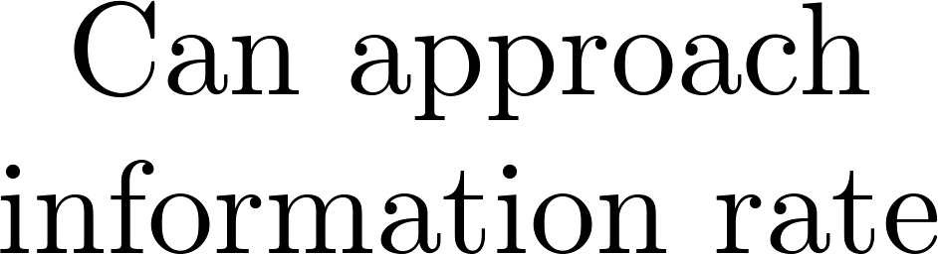
Avoiding High-Rate ADC
Use several samplers:
  Papoulis’ theorem
  Time-interleaved ADC (special case)
Exploit signal structure (subspace):
  Pulse streams
  Multiband sampling

Slide 27
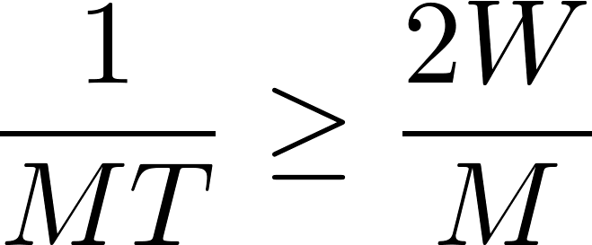










Papoulis’ Theorem
Model: bandlimited (same)
Sampling: branches sampled at the Nyquist rate,
Flexible constraints on
Reconstruction:
Papoulis, ‘77
Overall rate is (same)

Slide 28

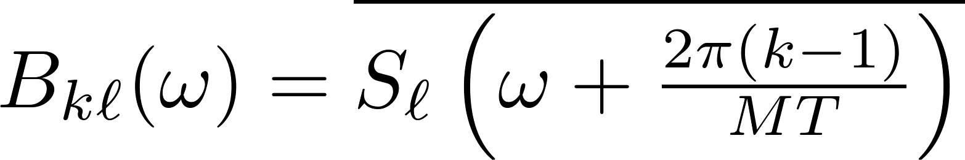
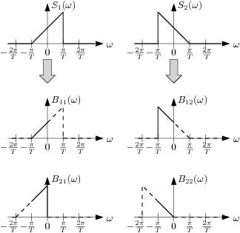
Papoulis’ Theorem
Condition on filters: The matrix B has to be invertible over
Recovery filters:

Slide 29
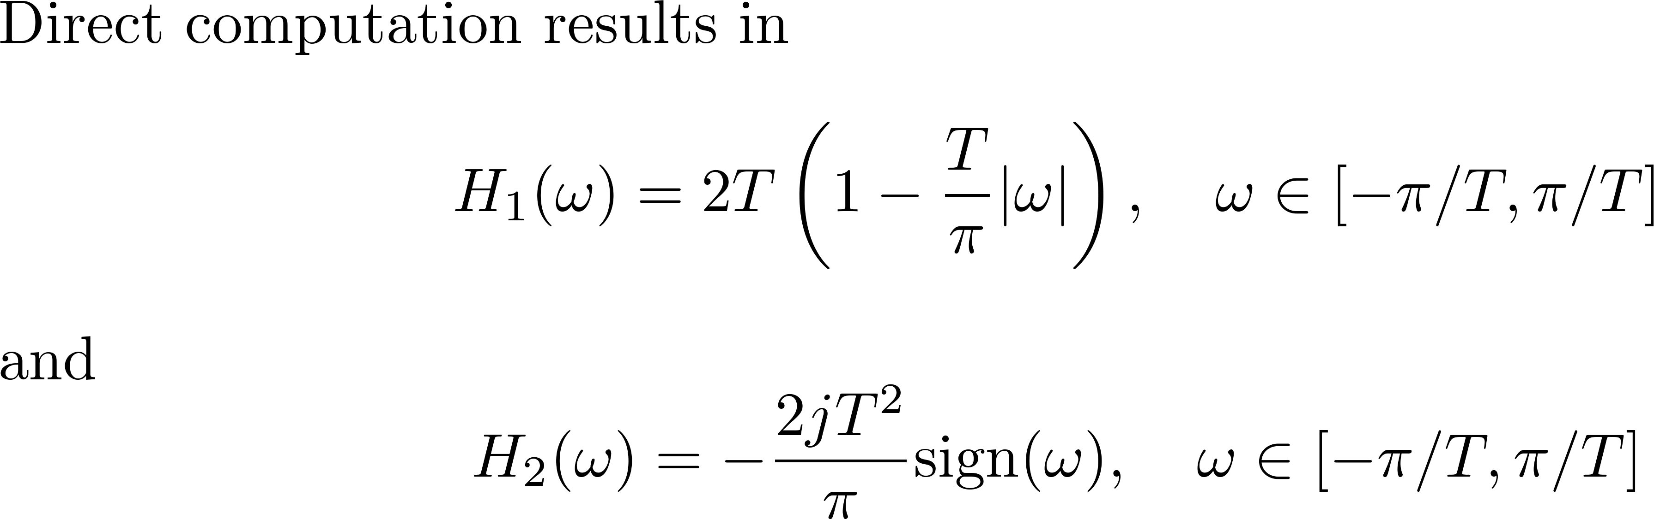
Example: Derivative Sampling

Slide 30














Time-Interleaved ADCs
A high-rate ADC comprised of a bank of lowrate devices
Analog Devices Corp.
Texas Instruments Corp.
MAXIM Corp.
National InstrumentsCorp.
Each branch (coset) undersamples at of
the Nyquist-rate
Widely-researched
Yen ’56, Eldar and Oppenheim ’00, Johansson and Lowenborg ’02,
Levy and Hurst ’04, and more…
Notes:
High rate samplers consist of several low rate ones because we cannot have one at high rate (quantization time)
We need to duplicate the T/H, and the quantizer.
This is a hybrid design – T/H with high BW but quantizer with low rate…. We can’t use low BW T/H, since we need *pointwise* samples of the wideband input

Slide 31







Practical ADC Devices
Black and Hodges, ‘80
Jenq, ‘90
Elbornsson et al., ‘05
Divi and Wornell, ‘09
Murmann et al., ‘09
Goodman et al., ’09
…and more
In time-interleaved architectures:
The overall rate is Nyquist
Each branch needs front-end with Nyquist bandwidth
(will be important later)
Accurate time delay are required

Slide 32










Generalized Sampling in a Subspace
Model: Shift-invariant (SI) subspace of possible inputs
Practical ! e.g., splines, pulse amplitude modulation (PAM), and more…
Splines: central B-spline

Slide 33











Non-Pointwise Linear Sampling
Sampling functions
Generalized anti-aliasing filter
Local averaging
Electrical circuit
Sampling space:

Slide 34








Main Tool: Fourier Transforms
All manipulations in SI spaces can be carried out in Fourier domain!
Continuous time FT:
Discrete time FT: - periodic
DTFT of sampled sequence :
If is used to create :

Slide 35






Correlation Sequences
samples
Samples can be written as
In the Fourier domain:
The set is orthonormal if

Slide 36














Reconstruction from Generalized Samples
Shift-invariant case
  Model:
  Sampling:
  Recovery: Filter by to obtain , then interpolate
Sampling rate is rather than the Nyquist rate of
Approach does not depend on
Aldroubi and Unser, ‘94
Christensen and Eldar, ‘05

Slide 37
















Multiple Shift-Invariant Generators
Model:
Sampling / Reconstruction:
Sampling rate is → independent of
de Boor, DeVore and Ron , ‘94
Christensen and Eldar, ‘05
Previous work extends theory to arbitrary subspaces
Many beautiful results, and many contributors
(Unser, Aldroubi, Vaidyanathan,Blu, Jerri, Vetterli, Grochenig, DeVore,Christensen,Schoenberg,Eldar …)
More information:
Y. C. Eldar and T. Michaeli,
“Beyond Bandlimited Sampling,”
IEEE Signal Proc. Magazine,
26(3): 48-68, May 2009

Slide 38




Toy-Example (1)
1
Model:
Sampling: choose
3 adjacent shifts contributes to each sample
Recovery: exploit known shape
Subspace
prior
Rate:
can be very high, since is not bandlimited

Slide 39





Toy-Example (2)
Model:
Perfect recovery !
Rate:
is high…
Lowpass data can contain all relevant information !
Notes:
39

Slide 40













Pulse-streams (known locations)
Model: fixed delays , unknown
Sampling: design and sample
are known
Recovery: satisfy a linear system, with coefficients depending on
Rate:
is high, since is not bandlimited
Notes:
We focus on 1-d continuous inputs x(t), and particularly multiband frequency supports
A common practice in acquisition of RF signals is undersampling or demodulation

Slide 41





Generalized Sampling in Practice
So far:
Toy-examples: perfect recovery of nonbandlimited inputs !
Pulse streams, known pulse shape and fixed delays
A common denominator
Design assumption
Sampling & processing rates
High
exact knowledge
Approach minimal
Next slides: Multiband signals, known carrier frequencies

Slide 42

Mutliband (known carriers)
AM
FM
QAM
QPSK
Model: narrowband transmissions in wideband range,
modulated on carrier frequencies
Sampling:
  RF demodulation
  Undesampling
  Nonuniform strategies
Utilize knowledge
Sampling and processing at rate are often impractical
Notes:
We focus on 1-d continuous inputs x(t), and particularly multiband frequency supports
A common practice in acquisition of RF signals is undersampling or demodulation

Slide 43







Landau’s Theorem
States the minimal sampling rate for any (pointwise) sampling strategy
that utilizes frequency support knowledge
Theorem (known spectral support)
Landau, ‘67
Average sampling rate
bands, individual widths , requires at least samples/sec
Note: → bandpass with single-side width requires samples/sec
→ transmissions result in bands (conjugate symmetry)

Slide 44


RF Demodulation
AM
FM
QAM
QPSK
Lowpass
DSP
Interp.
value is used in sampling and reconstruction
Analog preprocessing with RF devices (1 branch/transmission)
Minimal rate:
Zero-IF, low-IF topologies
Crols and Steyaert, ‘98
Notes:
We focus on 1-d continuous inputs x(t), and particularly multiband frequency supports
A common practice in acquisition of RF signals is undersampling or demodulation

Slide 45



Undersampling
a.k.a. bandpass sampling
QPSK
DSP
Interp.
Sampling: Select rate to satisfy ``alias free condition’’
Reconstruction: Same as in RF demodulation
No analog preprocessing
Notes:
The method suits a single transmission (bandpass), and the rate depends on the band positioning (to avoid self-aliasing)
We can achieve the minimal rate only in integer positioning
No analog hardware (exploits aliasing) but suits only a bandpass input because of the alias-free condition
As we will see in the sequel, it is not precisely true that this is below Nyquist, because the ADC needs Nyquist-rate front-end, but for now we can refer to this as no analog preprocessing

Slide 46





Allowed Undersampling Rates
Sampling rate must be chosen in accordance to band location:
Vaughan et al., ‘91
Allowed
Forbidden
~150% increase
above optimal
Robustness to model mismatch requires significant rate increase
Multiband alias-free conditions are complicated and generally
do not result in significant rate reduction

Slide 47






Periodic Nonuniform Sampling
Advantages:
  No analog preprocessing
  No ``alias-free’’ conditions, works for multiband
  Approach minimal rate
Sampling:
In general, a p’th-order PNS can resolve up to p aliases:
  Bandpass sampling at average rate 2B
  Multiband sampling at rate approaching minimal
Kohlenberg, ‘53
Lin and Vaidyanathan, ‘98
Notes:
In the drawing, for bandpass, 2 overlaps get different weigthing in the 2 branches so that we can resolve them out
We will elaborate on that more when we describe our first sampling strategy which also relies on nonuniform sampling
The choice of phi_i depends on the band positions (in order to create linear independent mixtures). The recosntruction filters have piecewise constant responses, which depends on both band positions and choice of delays

Slide 48




















Reconstruction from 2nd order PNS
Delays result in different linear combinations of the bands

Slide 49











Multi-Coset Sampling
PNS with delays on the Nyquist grid
2
Analog signal
0
Point-wise samples
0
3
3
2
0
3
2
Samples can be written as where contains the non-zero
bands and
Notes:
They sit on the same platform (e.g. receiver) so no real advantage for semi-blind

Slide 50


Multi-Coset Sampling
PNS with delays on the Nyquist grid
Semi-blind approaches:
  Choose universally (or at random)
  Design reconstruction filters
Herley et. al., ‘99
Bresler et al., ‘00
``Blind’’ recovery:
Bresler et al., ‘96,'98
Positions are implicitly assumed:
  depends on band positions
  Recovery fails if incorrect value is used for
  Result requires random signal model, and holds almost surely
Completely blind = Unknown carriers = not a subspace model !
Notes:
They sit on the same platform (e.g. receiver) so no real advantage for semi-blind

Slide 51
Short Summary
Subspace models
  Linear, easy to treat mathematically
  Not necessarily bandlimited
Generalized sampling theory
  Treat arbitrary subspace models
  Many classic approaches can be derived from theory
  Rate is proportional to actual information rate rather than Nyquist
But, what if…
the input model is not linear ?
(for example, when carrier frequencies or times of arrivals are unknown)
Answer: the rest of this tutorial

Slide 52




Nonlinear Models – Motivation
Encountered in practical applications:
  Cognitive radio mobiles utilize unused spectrum ``holes’’,
  spectral map is unknown a-priori

Slide 53



Nonlinear Models – Motivation
Ultrasonic probe
Encountered in practical applications:
  Cognitive radio mobiles utilize unused spectrum ``holes’’,
  spectral map is unknown a-priori
  Ultrasound, reflections are intercepted at unknown delays
Rx signal
Unknowns
Do not fit subspace modeling … we can always sample at rate
Questions:
  Better modeling? Subspace up to some uncertainty ?
  Can we sample and process at rates below with proper modeling?

Slide 54
– Part 3 –
Union of Subspaces
→ Outline

Slide 55













Model
Signal belongs to one out of (possibly infinitely-)many subspaces
Lu and Do, ‘08
Eldar and Mishali, ‘09
Each corresponds to a different subspace
belongs to , for some → But, is unknown a-priori
is a nonlinear model:
A union is generally a true subset of its affine hull:
The union tells us more about the signal!

Slide 56






Union Types
4 types:
Legend:
  = General analog union models
  Infiniteness enters in either
  = Discrete models, e.g., sparse trigonometric polynomials

Slide 57











Examples: Analog Unions (1)
Pulses with unknown time delays
Dimensions:
A special case of a broader model: finite rate of innovation (FRI)
Here, innovation rate =
Vetterli et al., ’02-’11
Sequences of innovation model has both dimensions infinite
Gedalyahu and Eldar, ’09-’11

Slide 58





Examples: Analog Unions (2)
Multiband with unknown carrier frequencies
Dimensions:
Another viewpoint with is described later on
(efficient hardware and software implementation)
Mishali and Eldar ’07-’11

Slide 59
Examples: Discrete Unions
Signal model has underlying finite parameterization
Continuous-time examples:
  Sparse trigonometric polynomials
Kunis and Rauhut, ’08
Tropp et al., ’09
  Sparse piece-wise constant with integer knots
Discrete-time examples:
  Compressed sensing
  Block sparsity, tree-sparse models
Donoho, Candès-Romberg-Tao, ‘06
Baraniuk et al., Eldar et al., ’09-’11

Slide 60







Compressed Sensing = Union
Each is a subspace
- sparse
Sparsity models have been used successfully in many applications such as:
Denoising and deblurring
Tracking and classification
Compressed sensing
Donoho, Johnstone, Mallat, Sapiro, Ma, Vidal, Starck, …
Candès, Romberg, and Tao ‘06
Donoho ‘06

Slide 61
Compressed Sensing
CS
For sub-Nyquist sampling, our focus is on infinite unions
We will start with compressed sensing (CS)
  easier to explain
  methods for infinite unions also rely on CS algorithms
Following a short intro on CS → Xampling and analog systems

Slide 62


Short Intro
“Can we not just directly measure the part that will not end up being thrown away ?”
Donoho, ‘06
Original 2500 KB
100%
Compressed 148 KB
6%

Slide 63










In a Nutshell…
Donoho, ‘06
Candès-Romberg-Tao, ‘06
Notes:
63

Slide 64



Uniqueness of Sparse Representations
How many samples are needed to ensure uniqueness?
V
V
V
V
v
Problem: Condition hard to verify
Notes:
64

Slide 65





Coherence
Donoho et al., ‘01
Tropp, ‘04
The coherence of A is defined by (assuming normalized columns)
Welch bound:
When
Uniqueness of y=Ax can be expressed in terms of as
Under same condition we will see that efficient recovery is possible as well
Notes:
65

Slide 66

Restricted Isometry Property (RIP)
When noise is present uniqueness cannot be guaranteed
Would like to ensure stability
Can be guaranteed using RIP
A has RIP of order if
for any k–sparse vector x
In this case A is an approximate isometry
If A has unit-columns and coherenc then it has the RIP with
Candès and Tao, ‘05
Notes:
66

Slide 67




Recovery of Sparse Vectors
Reconstruction:
Find the sparsest and consistent
NP-Hard !!
Alternative recovery algorithms (Polynomial-time):
Basis pursuit
Donoho, ‘06
Candès et al., ‘06
Convex and tractable
Candès, ‘08
Donoho and Elad, ‘03
Greedy algorithms
OMP, FOCUSS, etc.
Tropp, Elad, Cotter et al.,
Chen et al., and many others…
Notes:
67

Slide 68





Greedy Methods: Matching Pursuit
Essential algorithm:
  Choose the first “active” column (maximally correlated with )
  Subtract off to form a residual
  Repeat with
Very fast for small scale problems
Not as accurate/robust for large signals in the presence of noise
Orthogonal MP:
Mallat and Zhang, ‘93
Pati et al., ‘93
Improve residual computation
Notes:
68

Slide 69


Recovery In the Presence of Noise
-relaxation techniques (convex optimization problems)
  Basis pursuit denoising (BPDN) / Lasso:
  Dantzig selector:
Greedy approaches: stop when data error is on the order of the noise
Tibshirani ‘96
Chen et al., ‘98
Candès and Tao, ‘07
Notes:
69

Slide 70



Recovery Gurantees
Common settings:
Random sensing matrix A, random noise
  RIP (and similar properties) can be approximated w.h.p.
  RIP-based guarantees for Dantzig selector and BPDN:
Deterministic A and x, random
  RIP typically unknown, coherence must be used
  Coherence-based results for BPDN, OMP, thresholding:
Deterministic “adversarial” noise w:
  Guarantees on order of
Candès and Tao, ’07
Bicket et al., 09
Ben-Haim, Eldar and Elad, ’10
Donoho et al., ’06

Slide 71

The Sensing Matrix A
Random IID matrices ensure recovery with high probability for sub-Gaussian distributions (Gaussian, Rademacher , Bernoulli, bounded RVs …) when
Random partial Fourier matrices (or more generally unitary matrices) also ensure recovery with a slightly higher number of measurements
Some structured matrices work as well such as a Vandermonde matrix
Donoho, ‘06
Candès et al., ‘06
Tutorials on Compressed Sensing:
R. G. Baraniuk, “Compressive sensing,” IEEE Signal Processing Mag., 24(4), 118–124, July 2007.
E. J. Candès and M. B. Wakin, “An introduction to compressive sampling,” IEEE Sig. Proc. Mag., 25(3), 21–30, Mar. 2008.
M. Duarte and Y. C. Eldar, “Structured Compressed Sensing: From Theory to Applications,” TSP.
Y. C. Eldar and G. Kutyniok, “Compressed Sensing: Theory and Applications,” Cambridge Press.
Notes:
71

Slide 72


Sub-Nyquist in a Union
Imposing subspace model is inefficient, problems
  High-sampling rate
  Analog bandwidth issues
  Load on the digital processing due to the excessive rate
Generalized sampling theory for unions?
Still developing…
Apply CS on discretized analog models?
…at the price of model sensitivity, high computational loads, and
loss of resolution
Rule of thumb: 1 MHz Nyquist = CS with 1 Million unknowns !

Slide 73







Multiband: Discretization ?
Instead of analog multiband:
Work with discrete multi-tone:
Advantages:
Problems:
Model size:
Proportional to actual bandwidth
Proportional to Nyquist rate
Mishali, Eldar and Elron, ‘10

Slide 74




Multiband: Discretization ?
Instead of analog multiband:
Work with discrete multi-tone:
Advantages:
Problems:
Model size:
huge-scale
Sensitivity:
Cannot avoid grid mismatch
Negligible
(for a slight rate increase)
0.005% grid mismatch
Mishali, Eldar and Elron, ‘10
System “grid” must match signal tones grid

Slide 75



Multiband: Discretization ?
Instead of analog multiband:
Work with discrete multi-tone:
Advantages:
Problems:
Model size:
Sensitivity: Negligible
Analog
Discretization ?
System “grid” must match
the unknown signal tones grid
Computational load (100 MHz processer):
Realtime processing
Mishali, Eldar and Elron, ‘10

Slide 76



Discrete CS Radar
A discrete version of the channel is being estimated
Leakage effect → fake targets
Limited resolution to
Sampling process in hardware is unclear
Digital processing is complex and expensive
Leakage effect → fake targets
Bajwa, Gedalyahu and Eldar, ’11
Real channel
Discretized channel
Notes:
Moshiko: add ref to the graphs

Slide 77
ADCs: Why Not Standard CS?
CS is for finite dimensional models (y=Ax)
Loss in resolution when discretizing
Sensitivity to grid, analog bandwidth issues
Is not able to exploit structure in analog signals
Results in large computation on the digital side
Samples do not typically interface with standard processing methods
More elaborate signal models needed that exploit structure to reduce sampling and processing rates

Slide 78
Sub-Nyquist in a Union
Imposing subspace model is inefficient, problems
Generalized sampling theory for unions?
Still developing…
Apply CS on discretized analog models?
Discretization issues…
Must combine ideas from Sampling theory and CS recovery algorithms

Slide 79
– Part 4 –
Xampling
Functional approach to sub-Nyquist in a Union
  CS+Sampling = Xampling
X prefix for compression, e.g. DivX
→ Outline

Slide 80


Standard DSP Systems
High-rate
Low-rate
HW
SW
Sampling and processing at high rates = Nyquist of
After compression, data has low rate
Standard DSP software expects Nyquist-rate samples
rely on invariant properties
(enables digital filtering / digital estimation for example)
Move compression to hardware before ADC !

Slide 81











Xampling – Architecture
Low-rate
Low-rate
Low-rate
Mishali, Eldar and Elron, ‘10
Functional architecture: Both sampling and processing at low rate
→ Detection block outputs lowrate data that DSP can handle
Built bottom-up: based on practical and pragmatic considerations
Notes:
We call X-ADC… X-DSP… and as we shall see CS and other methods get into the play in the detection stage.

Slide 82
Xampling: Main Idea
Principle #1 (X-ADC):
Create several streams of data
Each stream is sampled at a low rate
(overall rate much smaller than the Nyquist rate)
Each stream contains a combination from different subspaces
New hardware design ideas
Principle #2 (X-DSP):
Identify subspaces involved (e.g., using CS)
Recover using standard sampling results
New DSP algorithms

Slide 83
Xampling Systems
Modulated wideband converter
Periodic nonuniform sampling (fully-blind)
Sparse shift-invariant framework
Finite rate of innovation sampling
Random demodulation
Mishali and Eldar, ‘07-’09
Mishali and Eldar, ‘07-’09
Eldar, ‘09
Vetterli et al., ’02-’07
Dragotti et al., ’02-’07
Gedalyahu, Tur and Eldar, ’10-’11
Tropp et al., ’09

Slide 84





Multiband Union
~
~
~
~
Each band has an uncountable number of non-zero elements
Band locations lie on the continuum
Band locations are unknown in advance
no more than N bands, max width B, bandlimited to
Mishali and Eldar, ‘07
Notes:
84
84

Slide 85




Optimal Blind Sampling Rate
Theorem (known spectral support)
Landau, ‘67
Average sampling rate
Theorem (unknown spectral support)
Mishali and Eldar, ‘07
The minimal rate is doubled
bands, individual widths , requires at least samples/sec

Slide 86
















The Modulated Wideband Converter
~
~
~
~
Mishali and Eldar, ’09
Notes:
86

Slide 87







Recovery From Xamples
~
~
~
~
Cannot invert a fat matrix!
Spectrum sparsity: Most of the are identically zero
For each n we have a small size CS problem
Problem: CS algorithms for each n → many computations
Notes:
87

Slide 88







Reconstruction Approach
Solve finite
problem
Reconstruct
S = non-zero rows
0
1
2
CTF
(Support recovery)
3
4
Continuous
Finite
5
6
The matrix V is any basis for the span of
Notes:
88

Slide 89





Underlying Theory
Construct a frame
for
Solve MMV
Theorem [Exact Support Recovery, CTF]
Mishali and Eldar, ‘08
CTF = Continuous to Finite

Slide 90






Insight into CTF
Run CS recovery
for each time-instance
nonlinear
Computationally heavy
Construct frame
Solve CS system
Apply on
for each time-instance
easy
nonlinear
linear
Computationally light

Slide 91


Reconstruction
High-level architecture
Mishali and Eldar, ‘07-’10
CTF
(Support recovery)
Analog
Back-end
(Realtime)
DSP
(Baseband)
Memory
Detector
Recover any desired spectrum slice at baseband

Slide 92








Reconstruction
High-level architecture
Mishali and Eldar, ‘07-’10
CTF
(Support recovery)
Analog
Back-end
(Realtime)
DSP
(Baseband)
Memory
Detector

Slide 93

Reconstruction
High-level architecture
Mishali and Eldar, ‘07-’10
CTF
(Support recovery)
Analog
Back-end
(Realtime)
DSP
(Baseband)
Memory
Detector
Can reconstruct:
The original analog input exactly (without noise)
Improve SNR for noisy inputs, due to rejection of out-of-band noise
Any band of interest, modulated on any desired carrier frequency

Slide 94





Sign-Flipping Periodic Waveforms
rectangular (signs)
square (DFT)
Theorem [Expected-RIP for MWC]
ExRIP – RIP holds
with probability p
Mishali and Eldar, ‘09

Slide 95




Time Appearance of Mixing Waveforms
Bad news: can’t design nice sign patterns at GHz rates
Good news: only the periodicity matters !
Competing approaches (pure CS) struggle with time appearance

Slide 96




Simulation
~
~
~
~
Notes:
96

Slide 97
Sub-Nyquist Demonstration
Carrier frequencies are chosen to create overlayed aliasing at baseband
+
+
Overlayed sub-Nyquist
aliasing around 6.171 MHz
FM @ 631.2 MHz
AM @ 807.8 MHz
Sine @ 981.9 MHz
MWC prototype
10 kHz
100 kHz
Reconstruction
(CTF)
1.5 MHz
FM @ 631.2 MHz
AM @ 807.8 MHz
Mishali et al., ‘10

Slide 98
Xampling Systems
Modulated wideband converter
Periodic nonuniform sampling (fully-blind)
Sparse shift-invariant framework
Finite rate of innovation sampling
Random demodulation
Mishali and Eldar, ‘07-’09
Mishali and Eldar, ‘07-’09
Eldar, ‘09
Vetterli et al., ’02-’07
Dragotti et al., ’02-’07
Gedalyahu, Tur and Eldar, ’10-’11
Tropp et al., ’09

Slide 99



















Fully-Blind PNS Approach
~
~
~
~
Mishali and Eldar, ‘07

Slide 100






Can Avoid RF Front-end ?
?
=
YES ! If the input bandwidth is not too high…

Slide 101
Practical ADC Devices
In non-uniform sampling:
Both T/H and mux operate at the Nyquist rate
Digital processing and recovery requires interpolation to the high Nyquist grid
Accurate time-delays are needed

Slide 102
Xampling Systems
Modulated wideband converter
Periodic nonuniform sampling (fully-blind)
Sparse shift-invariant framework
Finite rate of innovation sampling
Random demodulation
Mishali and Eldar, ‘07-’09
Mishali and Eldar, ‘07-’09
Eldar, ‘09
Vetterli et al., ’02-’07
Dragotti et al., ’02-’07
Gedalyahu, Tur and Eldar, ’10-’11
Tropp et al., ’09

Slide 103











Sparse Shift-Invariant Framework
Eldar, ‘09
Sampling signals from a structured union of shift-invariant spaces (SI)
There is no prior knowledge on the exact indices in the sum
Reconstruction
Real-time
processing
CTF
Sampling kernels
Reconstruction kernels
Theorem
Sampling theory
“Good” CS matrix

Slide 104
Xampling Systems
Modulated wideband converter
Periodic nonuniform sampling (fully-blind)
Sparse shift-invariant framework
Finite rate of innovation sampling
Random demodulation
Mishali and Eldar, ‘07-’09
Mishali and Eldar, ‘07-’09
Eldar, ‘09
Vetterli et al., ’02-’07
Dragotti et al., ’02-’07
Gedalyahu, Tur and Eldar, ’10-’11
Tropp et al., ’09

Slide 105



Pulse Streams
degrees of freedom per unit time
Delays and amplitudes are unknown
Applications:
  Communication
  Radar
  Bioimaging
  Neuronal signals
Special case of Finite Rate of Innovation (FRI) signals
Minimal sampling rate – the rate of innovation:
Vetterli et al., ’02

Slide 106
Analog Sampling Stage
Naïve attempt: direct sampling at low rate
Most samples do not contain information!!
Sampling rate reduction requires proper design of the analog front-end
Special cases:
Periodic pulse streams
Finite
Infinite pulse streams
Vetterli et al., ’02-’05
Dragotti et al., ’07-’10
Tur et al., ’10-’11
Gedalyahu et al., ’09

Slide 107


Periodic Pulse Streams
Periodic FRI signal model:
  The function h(t) and the period are known
Since x(t) is periodic it has a Fourier series with coefficients
Spectral estimation: sum of complex exponentials problem
Solved using 2L measurements
  Methods: annihilating filter, MUSIC, ESPRIT
Vetterli et al., ’02-’05
Schmidt, ’86
Roy and Kailath, ’89
Stoica and Moses, ’97
Once the Fourier coefficients are known,
Standard solutions exist.
Challenge: How can we obtain the coefficients?
Notes:
The basis for both approaches lies within the framework of spectral estimation. In order to understand this relationship
We begin by observing the periodic FRI model.
We assume a tau-periodic signal of the form depicted here above. The pulse shape is known, and the goal is to recover L delays and amplitudes of its occurrences.

Slide 108




General Approach
Analog domain
Digital domain
Spectral Estimation
Find Fourier Coefficiens
Annihilating filter,
MUSIC, ESPRIT…
Sub-Nyquist
“Mixing” filter
Samples linear combinations of the Fourier coefficients
Identify signal
subspace
(= X-DSP)
Notes:
In the analog domain, the FRI signal is filtered with the compactly supported kernel s*(-t) and then sample at interval T, such that N>=2L samples are obtained uniformly within the interval [0,tau).
The filtering and sampling block results in a set of samples, c[n], such that each sample represents some mixture of the signal’s Fourier coefficients. Here we still regard the input signal as periodic.
As we soon show, proper selection of the kernel results in samples which are mixture of the required set of coefficients only. Furthermore, the mixing operator is invertible, such that we may retrieve the coefficients via Digital processing.
The next step involves spectral estimation for extracting the set of delays. Least square method is finally utilized for retrieving the corresponding amplitudes.
(I have added the inverse of S to the equation x=pinv(V)c)

Slide 109










Find Fourier Coefficients
Fourier series of a periodic input:
Find Fourier Coefficiens
Unknown
Sensing with lowpass:
Known measurements

Slide 110







Annihilating ``Filter’’
Goal: design a digital filter with
has zeros at the ``frequencies’’ annihilates
Filter coefficients can be computed from the measurements:
Notes:
In the analog domain, the FRI signal is filtered with the compactly supported kernel s*(-t) and then sample at interval T, such that N>=2L samples are obtained uniformly within the interval [0,tau).
The filtering and sampling block results in a set of samples, c[n], such that each sample represents some mixture of the signal’s Fourier coefficients. Here we still regard the input signal as periodic.
As we soon show, proper selection of the kernel results in samples which are mixture of the required set of coefficients only. Furthermore, the mixing operator is invertible, such that we may retrieve the coefficients via Digital processing.
The next step involves spectral estimation for extracting the set of delays. Least square method is finally utilized for retrieving the corresponding amplitudes.
(I have added the inverse of S to the equation x=pinv(V)c)

Slide 111


X-ADC: Filter Choice
Theorem [Sufficient Condition]
Tur, Eldar and Friedman, ’11
Notes:
We now summarize the sufficient condition which the filter s(t) must satisfy, so that we may retrieve the set Kappa of Fourier coefficients from the samples c[n]

Slide 112


Special Cases
Low pass filter
Sum of sincs (SoS) in the frequency domain
In the time domain
Vetterli et al., ’02
Tur, Eldar and Friedman, ’11
Compact support!

Slide 113

Finite Pulse Streams
SoS filter can be used for finite streams due to its finite support!
Not true for LPF or other filters with long support
Far more robust than
Spline based methods –
works even for high L!

Slide 114




Multichannel Scheme
Proposed scheme:
Mix & integrate
Take linear combinations
from which Fourier coeff.
can be obtained
Samples
Fourier coeff. vector
Gedalyahu, Tur and Eldar, ’11
Supports general pulse shapes (time limited)
Operates at the rate of innovation
Stable in the presence of noise
Practical implementation based on the MWC
Single pulse generator can be used

Slide 115












Filter Bank Approach
Serial-to-Parallel
The analog sampling filter “smoothens” the input signal :
  Allows sampling of short-length pulses at low rate
  CS interpretation: each sample is a linear combination of the signal’s values.
The digital correction filter-bank:
  Removes the pulse and sampling kernel effects
  Samples at its output satisfy:
  The delays can be recovered using ESPRIT as long as
Gedalyahu and Eldar, ’09

Slide 116
Filter Bank vs. Single
Filter \ Modulation Bank
FRI models can be treated with both a FB structure or a single filter\modulation bank
Comparison:
FB MB
Model fixed delay in different periods varying delays
arbitrary time support support within one
period
Correction digital correction simple correction
with filter bank

Slide 117
Noise Robustness
MSE of the delays estimation, versus integrators approach
Kusuma and Goyal, ’06
L=2 pulses, 5 samples
L=10 pulses, 21 samples
The proposed scheme is stable even for high rates of innovation!

Slide 118





Application:
Multipath Medium Identification
Gedalyahu and Eldar, ’09-’10
LTV channel
propagation paths
pulses per period
Medium identification:
  Recovery of the time delays
  Recovery of time-variant gain coefficients
The proposed method can recover the channel parameters from
sub-Nyquist samples

Slide 119


Application: Radar
Each target is defined by:
  Range – delay
  Velocity – doppler
Bajwa, Gedalyahu and Eldar, ’11
Targets can be identified with infinite resolution as long as the time-bandwidth product satisfies

Slide 120

Xampling in Ultrasound Imaging
Motivation
  Generate a two-dimensional focused ultrasound image while reducing the sampling rate in each active element far below the Nyquist rate
  Sample rate reduction leads to significant reduction of data size, and implies potential reduction of machinery size and power consumption, while maintaining image quality
Wagner, Eldar, Feuer, Danin and Friedman, ’11
Reduction of sampling rate implies potential reduction of machinery size and power consumption
Portable
Systems
High-End
Systems
Low-End
Systems
Mid-Range
Systems

Slide 121


Xampling in Ultrasound Imaging
Main Results
  A scheme which enables reconstruction of a two dimensional image, from samples obtained at a rate 10-15 times below Nyquist
  The resulting image depicts strong perturbations in the tissue
Standard B-mode image, generated from samples obtained at Nyquist Rate
Xampled B-mode image, generated from samples obtained at 0.17 Nyquist Rate

Slide 122





Ultrasound Imaging & FRI
Digital Beamformer
  An ultrasonic pulse is transmitted
  into a tissue; echoes are scattered and reflected by density and propagation-velocity perturbations
  - Individual traces of reflected echoes, received by the multi-element transducer array
Meets the finite FRI model:
Unknowns
Beamformed Signal
Can we stably reconstruct pulse streams from low-rate samples?
Notes:
Towards conclusion, we would like to tie our results to ultrasound imaging.
We regard a typical B-mode scan, in which a planar cross section of the tissue is rendered.
An imaging cycle begins when a focused ultrasonic pulse is transmitted into the tissue by an array of transducer elements. The same array then receives echoes of the transmitted pulse, which are reflected by density and propagation-velocity perturbations inside the tissue.
In standard imaging devices, the received signals are now sampled at high rate (typically 20MHz per element) as dictated by Nyquist theorem.
The sampled signals are digitally combined with appropriate, time-varying delays, by a beamformer unit, resulting in a focused beam which corresponds to the perturbations along the path of the transmitted pulse.
We observe that the signal received in each element typically comprises streams of pulses originating in macroscopic perturbations, accompanied by noisy-like speckles, originating in microscopic perturbations. We may thus imply the finite FRI model onto the signal received by each element, where our goal is to recover the time-delays and amplitudes of relatively strong echoes.

Slide 123

Ultrasound Experiment
Real data acquired by GE Healthcare’s Vivid-i imaging system
Method applied on noisy signal
Excellent reconstruction from sub-Nyquist samples
Poor SNR motivates integration of the data from multiple receivers
Phantom comprising 5 equally spaced scatterers
  How should we combine the information from all channels in the compressed domain?
Notes:
In the following ultrasound experiment we used our Multi-Channel sampling scheme in order to sample an actual signal which was detected by a single transducer element.
The data was acquired by a GE Healthcare’s Vivid-i imaging system, in a setup comprising five scattering elements.
In this scenario, sampling the signal at Nyquist rate results in approximately 4000 samples per interval tau. Our reconstruction, on the other hand, is based on N=17 samples only. We manage to obtain good estimation of the significant transients, despite the speckle noise.
Nevertheless, the poor SNR and the need to combine multiple 1D signals into a single 2D image, motivates us to integrate data from multiple receivers.
123

Slide 124







Beamforming in the Compressed Domain
Wagner, Eldar, Feuer, Danin and Friedman, ’11
Conceptual beamforming
1D Xampling
Distortion, -M
Beamformed
signal
Distortion, m
Distortion, m
Distortion, M
Notes:
Here we present a preliminary approach, of which details are beyond the scope of the current session.
The idea is to modify the modulating kernels applied in the multi-branch scheme, such that the resulting samples are invariant to the offset of the transducer element relative to the constructed beam. In such manner the received signals may be combined for SNR reduction and for obtaining a signal which may be translated to an actual image line.
The slide illustrates the main concept:
We begin with a scheme in which a beam is “conceptually” formed from received signals in the analog domain and then injected into the multichannel Xampling block.
We end with a scheme in which the required signal distortions are translated into modifying the modulating kernels, such that the Xampling block once

Slide 125


Beamforming in the Compressed Domain
Wagner, Eldar, Feuer, Danin and Friedman, ’11
Samples from
the rest of the
active elements
1D Xampling
Standard Imaging
Xampled Image,
Dynamic Focusing with
L = 30; ρ = 3.
Distortion, m
Distortion, m
Samples from
the rest of the
active elements
RF ultrasound data provided by
Dr. Omer Oralkan and Prof. Pierre Khuri-Yakub of the E. L. Ginzton Laboratory at Stanford University.
Notes:
We end with a scheme in which the required signal distortions are translated into modification of the modulating kernels, such that the Xampling block is once again applied to the actual analog input.
The left image was generated via standard sampling and beam-forming techniques, whereas the right image was obtained with about 1/5 the number of samples, by assuming 30 reflecting elements along a single image line, and with factor 3 oversampling.

Slide 126

Application to GPS Acquisition
  Goal: reducing complexity in GPS acquisition by using fewer correlators
  Signal model:
Li, Rueetschi, Eldar and Scaglione, ’11
satellite code

Slide 127


Received Signal
  For triangulation we only need about 4 of the strongest satellite codes
  To reduce the number of correlators we MF against a linear combination of all possibilities:
  Repeat several times with different combinations
Li, Rueetschi, Eldar and Scaglione, ’11

Slide 128

Results
  MF requires 10,000 correlators
  Can meet performance with far fewer correlators
  Same idea applies to multi-user detection
  (Xie, Eldar and Goldsmith, 10)

Slide 129
Xampling Systems
Modulated wideband converter
Periodic nonuniform sampling (fully-blind)
Sparse shift-invariant framework
Finite rate of innovation sampling
Random demodulation
Mishali and Eldar, ‘07-’09
Mishali and Eldar, ‘07-’09
Eldar, ‘09
Vetterli et al., ’02-’07
Dragotti et al., ’02-’07
Gedalyahu, Tur and Eldar, ’10-’11
Tropp et al., ’09

Slide 130
















Random Demodulation
Model: sparse sum of harmonic tones
Tropp et al., ‘09
Sampling:
Nyquist-rate

Slide 131















Random Demodulation
Reconstruction:
Nyquist-rate
Use CS solvers to recover , then reconstruct
Numerical simulations: 32 kHz AM signal recovered from sampling
at 10% Nyquist rate
Tropp et al., ‘09
Similar to MWC? Next part describes the differences…

Slide 132














Nyquist Folding
Rate reduction using nonlinear sampling effects:
Lowpass
Fudge et al., ‘08

Slide 133


Summary: Xampling Systems
X-DSP | X-ADC | Strategy |  | Model
CTF | Periodic mixing | MWC Mishali-Eldar 09 |  | Multiband
CTF | time shifts | PNS Mishali-Eldar 08
 | Jittered undersampling | Nyquist-folding Fudge et al. 08
CTF | Filter-bank | Eldar 08 |  | Sparse shift-invariant
Annihilating filter | Lowpass | Periodic Vetterli et al. 02-05 |  | FRI (time-delays)
Moments factoring | Splines | One-shot Dragotti et al. 07
Annihilating filter | Sum-of-Sincs filtering | Periodic/one-shot Gedlyahu-Tur-Eldar 09-10
MUSIC or ESPRIT | Lowpass or periodic mixing + integration | Gadlyahu-Eldar 09 |  | Sequences of innovation
CS | Sign flipping + integration | RD Tropp et al. 09 |  | Harmonic tones
``Xampling: Signal Acquisition and Processing in Union of Subspaces’’, Mishali, Eldar and Elron, TSP ‘11

Slide 134
– Part 5 –
From Theory to Hardware
→ Outline

Slide 135





Theory vs. Practice
Practical considerations affect the choice of a sampling solution
Example 1: Multiband sampling (known carriers )
 | RF demodulation | Nonuniform methods
Minimal analog preprocessing
ADC with low analog bandwidth
Example 1: Pulse streams (known delays )
 |  | Digital match filter
Low sampling rate
Robustness to model mismatch
✓

Slide 136
ADC Market
State-of-the-art ADCs generate Nyquist samples
Today’s challenges:
  Increase sampling rate (Giga-samples/sec)
  Increase front-end bandwidth
  Increase (effective) number of bits

Slide 137
Sub-Nyquist: Practical Challenges
Goal: Shift challenge away from ADC technology
No free lunches ! Signal has frequencies until
Nyquist will enter elsewhere into system design
Practical design metrics:
  robustness to model mismatches
  flexible hardware design
  light computational loads
  imaging: high resolution
  noise performance
  power, area, size, cost, …
Next slides:
  Study practical metrics of example sub-Nyquist systems (RD/MWC)
  Glance into sub-Nyquist circuit challenges
  Sub-Nyquist imaging: analog vs. discrete CS
Focus of this part

Slide 138






Random Demodulator
Robustness:
0.005% grid mismatch
Tropp et al., ‘09
Required hardware accuracy (so that ):
``Nice’’
time-domain
appearance
Accurate integrator:
Computational load:
Reported hardware:
Ragheb et al., ‘08
Yu et al., ‘10

Slide 139







Modulated Wideband Converter
Robustness:
Inequalities allow model mismatches
Required hardware accuracy:
``Nice’’
freq.-domain
appearance
Mishali and Eldar, ‘09
Nonideal lowpass response can be compensated digitally
Chen et al., ‘10
Computational load:
Reported hardware:
Mishali et al., ‘11

Slide 140
Hardware Accuracy
Sign alternating functions at 2 GHz rate
Time appearance
Frequency appearance

Slide 141
Comparison
Visually-similar systems – major differences in practical metrics
Tropp et al., ‘09
Mishali and Eldar, ‘09
No free lunches… Nyquist enters in:
  Time-domain accuracy
  Computational loads
  Freq.-domain accuracy
  (handled by RF front-end)
Similar conclusions in other applications?

Slide 142
CS Radar
A discrete version of the channel is being estimated
Leakage effect → fake targets
Limited resolution to
Sampling process in hardware is unclear
Digital processing is complex and expensive
Leakage effect → fake targets
Real channel
Discretized channel
Notes:
Moshiko: add ref to the graphs

Slide 143
ADCs: Why Not Standard CS?
CS is for finite dimensional models (y=Ax)
Loss in resolution when discretizing
Sensitivity to grid, analog bandwidth issues
Is not able to exploit structure in analog signals
Results in large computation on the digital side
Samples do not typically interface with standard processing methods
More details in: M. Mishali, Y. C. Eldar, and A. Elron, “Xampling: Signal acquisition and processing in union of subspaces”
Besides union models and Xampling there are many more challenges !

Slide 144
Stepping CS to Practice
Address wideband noise and dynamic range:
  Since x is noisy: y=A(x+e)+w, e=wideband noise
  MWC/PNS: Nyquist-bandwidth noise is aliased
  RD: noise is folded from all possible tone locations
  Large interference will swamp ADC
Integrate into existing systems
  Minimal (preferably no) modification to hardware
  e.g., reprogramming firmware, rewiring, etc.
  Deal with large analog BW and wide dynamic range
Prove cost-effective
  Rate is only one factor ! Digital complexity is not less important
  Improve effective number of bits / Xample
Next slides: quick glance at circuit challenges + applications

Slide 145


A 2.4 GHz Prototype
2.3 GHz Nyquist-rate, 120 MHz occupancy
280 MHz sampling rate
Wideband receiver mode:
  49 dB dynamic range
  SNDR > 30 dB over all input range
ADC mode:
  1.2 volt peak-to-peak full-scale
  42 dB SNDR = 6.7 ENOB
Off-the-shelf devices, ~5k$, standard PCB production
Mishali and Eldar, ’08-10

Slide 146
Circuit Design (2)
Analog board
  m=4 channels
  1:4 Split + mixing + filtering
  Filter cutoff 33 MHz
  Sampling rate 70 MHz per channel (scope)
Digital board: sign alternating sequences
  2.075 GHz VCO
  Discrete ECL shift-register
  M=108 bits
  4 Outputs (taps of the register)
Mishali and Eldar, ’08-10

Slide 147
Circuit Design (3)
Wideband receiver mode:
  Gain control on the input
  Design specifications:
  Power out > -7 dBm
  SNDR > 30 dB
  over all input range
  Gives 49 dB dynamic range
Mishali and Eldar, ’08-10

Slide 148






Analog Design
Mishali et al., ‘10

Slide 149






Digital Design
Mishali et al., ‘10

Slide 150



Mixing with Periodic Functions
Fine biasing due to sinusoids power split
Cannot equalize
entire path
support wideband LO
Datasheet specifications are for single LO mixing
(conversion loss, IP3, required power) !
Mishali et al., ’10

Slide 151


Highly-Transient Periodic Waveforms
We selected the sign pattern which gives about the same harmonic levels
Tap locations: 5th bit in every consecutive 24 bits (layout considerations only)
Mishali et al., ‘10

Slide 152
Sub-Nyquist Demonstration
Carrier frequencies are chosen to create overlayed aliasing at baseband
+
+
Overlayed sub-Nyquist
aliasing around 6.171 MHz
FM @ 631.2 MHz
AM @ 807.8 MHz
Sine @ 981.9 MHz
MWC prototype
10 kHz
100 kHz
Reconstruction
(CTF)
1.5 MHz
FM @ 631.2 MHz
AM @ 807.8 MHz
Mishali et al., ‘10

Slide 153











Application: Cognitive Radio
hole
hole
~
~
~
~
Xampling for Spectrum Sensing
Sub-Nyquist sampling
Detect active
spectrum slices
Fine support
detection
For example:
Mishali and Eldar, ’11
Notes:
Emphasize that this is a degenerated version of the MWC for the task of spectrum sensing

Slide 154


Simulations
3 QPSK transmissions, Symbol rate = 30 MHz,
Quality measure, CFO = Carrier frequency offset
Satisfies IEEE 802.11 40ppm specifications of standard transmissions
around 3.75 GHz
Mishali and Eldar, ’11
Notes:
In the simulations we used 3 QPSK signals
The carriers, bits, energy etc were all drawn randomly. However, emphasize that the system parameters were fixed (no random in the operator)
As can be seen > 99% of the simulations (100 trials X 3 transmission = 300) were within 150 kHz, this was done for SNR=15 dB
For other SNR values and other CFO_max (30/70/100/200 kHz) the second plot shows a graceful behavior

Slide 155

Experiments
Mishali and Eldar, ’11

Slide 156

Take-Home Message
Compressed sensing uses finite models
Xampling works for analog signals
Compression
Sampling
Must combine ideas from Sampling theory and algorithms from CS
  CS+Sampling = Xampling
X prefix for compression, e.g. DivX

Slide 157
Summary: Next Big Challenge
Develop cost-effective CS hardware solutions
Address wideband noise and dynamic range
Integrate into existing hardware solutions
Innovate at the circuit level: wideband input and large dynamic range
Design provable hardware
  at lab
  on-board
  on-chip
Become a mature technology !

Slide 158
Conclusions
Q & A
→ Outline

Slide 159
Conclusions
Union of subspaces: broad and flexible model
Can lead to simple and efficient algorithms
Includes analog signal models
Sub-Nyquist sampler in hardware
Compressed sensing of many classes of analog signals
Many research opportunities: extensions, robustness, hardware, mathematical …
Compressed sensing can be extended practically to the infinite analog domain!

Slide 160
Opinion
Burst of innovative publications
Theory is still developing, yet the basic principles are understood
Next frontier: Hardware implementations
Become a mature technology !
More details in:
M. Mishali and Y. C. Eldar, “Sub-Nyquist Sampling: Bridging Theory and Practice,’’ Sig. Proc. Mag.
M. Duarte and Y. C. Eldar, “Structured Compressed Sensing: From Theory to Applications,” TSP.
M. Mishali and Y. C. Eldar, “Xampling: Compressed Sensing of Analog Signals,’’ in book, Cambridge press.

Slide 161
References +
Online Documentations
→ Outline

Slide 162








Online Demonstrations
GUI package of the MWC
Video recording of sub-Nyquist sampling + carrier recovery in lab
SiPS 2010
2010 IEEE Workshop on
Signal Processing Systems

Slide 163


Xampling Website
webee.technion.ac.il/people/YoninaEldar/xampling_top.html

Slide 164




Acknowledgements
Students:
Moshe Mishali
Kfir Gedalyahu
Ronen Tur
Noam Wagner
Collaborators:
General Electric Israel – Zvi Friedman
National Instruments Corp. – Ahsan Aziz, Sam Shearman, Eran Castiel
Sponsors:
Newcom Network of Excellence
Israel Science Foundation
Magneton
Thank you!
We’ll be happy to hear your comments, ideas for future work etc yonina@ee.technion.ac.il

Slide 165
References
Tutorials:
M. Mishali and Y. C. Eldar, “Sub-Nyquist Sampling: Bridging Theory and Practice,’’ IEEE Sig. Proc. Mag.
M. Duarte and Y. C. Eldar, “Structured Compressed Sensing: From Theory to Applications,” TSP
M. Mishali and Y. C. Eldar, “Xampling: Compressed Sensing of Analog Signals,’’ in book, Cambridge press
Y. C. Eldar and G. Kutyniok, “Compressed Sensing: Theory and Applications,” Cambridge Press
Other Tutorials and Summaries:
R. G. Baraniuk, “Compressive sensing,” IEEE Sig. Proc. Mag., vol. 24, no. 4, pp. 118–120, 124, July 2007
E. J. Candès and M. B. Wakin, “An introduction to compressive sampling,” IEEE Sig. Proc. Mag., vol. 25,
pp. 21–30, Mar. 2008
J. Uriguen, Y. C. Eldar, P. L. Dragotti and Z. Ben-Haim, "Sampling at the Rate of Innovation: Theory and Applications,’’ in book, Cambridge press

Slide 166

References
Generalized Sampling Theory:
A. J. Jerry, “The Shannon sampling theorem-Its various extensions and applications: A tutorial review,” Proc. Of the IEEE, vol. 65, no. 11, pp. 1565-1596, Nov. 1977
A. Aldroubi and M. Unser, “Sampling procedures in function spaces and asymptotic equivalence with Shannon’s sampling theory,” Numer. Funct. Anal. Optimiz., vol. 15, pp. 1-21, Feb. 1994
M. Unser and A. Aldroubi, “A general sampling theory for nonideal acquisition devices, “IEEE Trans. Signal Process., vol. 42, no. 11, pp. 2915-2925, Nov. 1994
C. de Boor, R. DeVore and A. Ron, “The structure of finitely generated shift-invariant spaces in ,” J. Funct. Anal, vol. 119, no. 1, pp. 37-78, 1994
A. Aldroubi, “Oblique projections in atomic spaces,” Proc. Amer. Math. Soc. , vol. 124, no. 7, pp. 2051-2060, 1996
M. Unser, “Sampling – 50 years after Shannon,” IEEE Proc., vol. 88, pp. 569-587, Apr. 2000
P. P. Vaidyanathan, “Generalizations of the sampling theorem: Seven decades after Nyquist,” IEEE Trans. Circuit Syst. I, vol. 48, no. 9, pp. 1094-1109, Sep. 2001
Y. C. Eldar and T. Michaeli, “Beyond bandlimited sampling,” IEEE Signal Process. Mag., vol. 26, no. 3, pp.
48–68, May 2009.
T. Michaeli and Y. C. Eldar, “Optimization Techniques in Modern Sampling Theory, ” in book
Cambridge Univ. Press, ch., pp. 266–314, 2010

Slide 167
References
Subspace Sampling:
I. Djokovic and P. P. Vaidyanathan, “Generalized sampling theorem in multiresolution subspaces,” IEEE Trans. Signal Process. , vol. 45, pp. 583-599, Mar. 1997
M. Unser, “Splines: A perfect fit for signal and image processing,” IEEE Signal Process. Mag., pp. 22-38, Nov. 1999
Y. C. Eldar and A. V. Oppenheim, “Filter bank reconstruction of bandlimited signals from nonuniform and generalized samples,” IEEE Trans. Signal Processing, vol. 48, no. 10, pp. 2864-2875, 2000
A. Aldroubi and K. Gröchenig, “Non-uniform sampling and reconstruction in shift-invariant spaces,” SIAM Review, vol. 43, pp. 585-620, 2001
Y. C. Eldar, “Sampling and reconstruction in arbitrary spaces and oblique dual frame vectors,” J. Fourier Analys. Appl., vol. 1, no. 9, pp. 77-96, Jan. 2003
O. Christensen and Y. C. Eldar, “Oblique dual frames and shift-invariant spaces,” Applied and Computational Harmonic Analysis, vol. 17, no. 1, pp. 48-68, Jul. 2004
O. Christensen and Y. C. Eldar, “Generalized shift-invariant systems and frames for subspaces,” J. Fourier Analys. Appl., vol. 11, pp. 299-313, 2005
Y. C. Eldar and T. Werther, “General framework for consistent sampling in Hilbert spaces,” International Journal of Wavelets, Multiresolution, and Information Processing, vol. 3, no. 3, pp. 347-359, Sep. 2005
Y. C. Eldar and O. Christensen, “Caracterization of Oblique Dual Frame Pairs,” J. Applied Signal Processing, vol. 2006, Article ID 92674, pp. 1-11
T. G. Dvorkind, Y. C. Eldar and E. Matusiak, “Nonlinear and non-ideal sampling: Theory and methods,” IEEE Trans. Signal Processing, vol. 56, no. 12, pp. 5874-5890, Dec. 2008

Slide 168
References
Multiband subspaces:
H. J. Landau, “Necessary density conditions for sampling and interpolation of certain entire functions,” Acta Math., vol. 117, pp. 37-52, Feb. 1967
A. Kohlenberg, “Exact interpolation of band-limited functions,” J. Appl. Phys., pp. 1432–1435, Dec. 1953
R. G. Vaughan, N. L. Scott, and D. R. White, “The theory of bandpass sampling,” IEEE Trans. Signal Process., vol. 39, no. 9, pp. 1973–1984, Sep. 1991
Y.-P. Lin and P. P. Vaidyanathan, “Periodically nonuniform sampling of bandpass signals,” IEEE Trans. Circuits Syst. II, vol. 45, no. 3, pp. 340-351, Mar. 1998
C. Herley and P. W. Wong, “Minimum rate sampling and reconstruction of signals with arbitrary frequency support,” IEEE Trans. Inform. Theory, vol. 45, no. 5, pp. 1555-1564, Jul. 1999
R. Venkataramani and Y. Bresler, “Perfect reconstruction formulas and bounds on aliasing error in sub-Nyquist nonuniform sampling of multiband signals,” IEEE Trans. Inf. Theory, vol. 46, no. 6, pp. 2173–2183, Sep. 2000

Slide 169
References
Union of Subspaces:
Y. M. Lu and M. N. Do, “A theory for sampling signals from a union of subspaces,” IEEE Trans. Signal Processing, vol. 56, no. 6, pp. 2334–2345, 2008
Y. C. Eldar and M. Mishali, “Robust recovery of signals from a structured union of subspaces,” IEEE Trans. Info. Theory, vol. 55, no. 11, pp. 5302–5316, 2009
T. Blumensath and M. E. Davies, “Sampling theorems for signals from the union of finite-dimensional linear subspaces,” IEEE Trans. Inf. Theory, vol. 55, no. 4, pp. 1872–1882, Apr. 2009
Xampling Framework:
Y. C. Eldar, “Compressed sensing of analog signals in shift-invariant spaces”, IEEE Trans. Signal Processing, vol. 57, no. 8, pp. 2986-2997, August 2009
Y. C. Eldar, “Uncertainty relations for analog signals,” IEEE Trans. Inform. Theory, vol. 55, no. 12, pp. 5742 - 5757, Dec. 2009
M. Mishali, Y. C. Eldar, and A. Elron, “Xampling: Signal acquisition and processing in union of subspaces,”
[Online] arXiv.org 0911.0519, Oct. 2009
M. Mishali, Y. C. Eldar, O. Dounaevsky, and E. Shoshan, “Xampling: Analog to digital at sub-Nyquist rates,” IET Circuits, Devices & Systems, vol. 5, no. 1, pp. 8–20, Jan. 2011

Slide 170
References
Modulated Wideband Converter / Fully-blind Multi-Coset:
M. Mishali and Y. C. Eldar, “Blind multiband signal reconstruction: Compressed sensing for analog signals,” IEEE Trans. Signal Processing, vol. 57, pp. 993–1009, Mar. 2009
M. Mishali and Y. C. Eldar, “From theory to practice: Sub-Nyquist sampling of sparse wideband analog signals,” IEEE Journal of Selected Topics on Signal Processing, vol. 4, pp. 375-391, April 2010
M. Mishali, Y. C. Eldar, O. Dounaevsky, and E. Shoshan, “Xampling: Analog to digital at sub-nyquist rates,” IET Circuits, Devices and Systems, vol. 5, no. 1, pp. 8–20, Jan. 2011
M. Mishali and Y. C. Eldar, “Reduce and boost: Recovering arbitrary sets of jointly sparse vectors,” IEEE Trans. Signal Processing, vol. 56, no. 10, pp. 4692–4702, Oct. 2008
M. Mishali and Y. C. Eldar, “Wideband spectrum sensing at sub-Nyquist rates,” to appear in IEEE Signal Process. Mag.; [Online] arXiv.org 1009.1305, Sep. 2010
Random Demodulator:
J. A. Tropp, J. N. Laska, M. F. Duarte, J. K. Romberg, and R. G. Baraniuk, “Beyond Nyquist: Efficient sampling of sparse bandlimited signals,” IEEE Trans. Inf. Theory, vol. 56, no. 1, pp. 520–544, Jan. 2010
Z. Yu, S. Hoyos, and B. M. Sadler, “Mixed-signal parallel compressed sensing and reception for cognitive radio,” in ICASSP, 2008, pp. 3861–3864
T. Ragheb, J. N. Laska, H. Nejati, S. Kirolos, R. G. Baraniuk, and Y. Massoud, “A prototype hardware for random demodulation based compressive analog-to-digital conversion,” in Circuits and Systems, 2008. MWSCAS 2008. 51st Midwest Symposium on, 2008, pp. 37–40
Z. Yu, X. Chen, S. Hoyos, B. M. Sadler, J. Gong, and C. Qian, “Mixed-signal parallel compressive spectrum
sensing for cognitive radios,” International Journal of Digital Multimedia Broadcasting, 2010

Slide 171
References
Pulse streams:
M. Vetterli, P. Marziliano, and T. Blu, “Sampling signals with finite rate of innovation,” IEEE Trans. Signal Process., vol. 50, no. 6, pp. 1417–1428, 2002
P. L. Dragotti, M. Vetterli, and T. Blu, “Sampling moments and reconstructing signals of finite rate of innovation: Shannon meets Strang Fix,” IEEE Trans. Signal Process., vol. 55, no. 5, pp. 1741–1757, May 2007
J. Kusuma and V. Goyal, “Multichannel sampling of parametric signals with a successive approximation property,” IEEE Int. Conf. Image Procesing (ICIP), pp. 1265–1268, Oct. 2006
C. Seelamantula and M. Unser, “A generalized sampling method for finite-rate-of-innovation-signal reconstruction,” IEEE Signal Process. Lett., vol. 15, pp. 813–816, 2008
E. Matusiak and Y. C. Eldar, “Sub-Nyquist sampling of short pulses: Theory,” [Online] arXiv.org 1010.3132
Z. Ben-Haim, T. Michaeli, and Y. C. Eldar, “Performance bounds and design criteria for estimating finite rate of innovation signals,” [Online] arXiv.org 1009.2221, Sep. 2010
L. Baboulaz and P. L. Dragotti, “Exact feature extraction using finite rate of innovation principles with an
application to image super-resolution,” IEEE Trans. Image Process., vol. 18, no. 2, pp. 281–298, Feb. 2009
K. Gedalyahu and Y. C. Eldar, "Time-delay estimation from low-rate samples: A union of subspaces approach," IEEE Trans. Signal Processing, vol. 58, no. 6, pp. 3017–3031, June 2010
R. Tur, Y. C. Eldar, and Z. Friedman, “Innovation rate sampling of pulse streams with application to ultrasound imaging,” IEEE Trans. Signal Process., vol. 59, no. 4, pp. 1827–1842, Apr. 2011
K. Gedalyahu, R. Tur, and Y. C. Eldar, “Multichannel sampling of pulse streams at the rate of innovation,” IEEE Trans. Signal Process., vol. 59, no. 4, pp. 1491–1504, Apr. 2011
W. U. Bajwa, K. Gedalyahu, and Y. C. Eldar, “Identification of underspread linear systems with application to super-resolution radar,” to appear in IEEE Trans. Signal Processing

Slide 172
References
Compressed sensing (#1):
D. L. Donoho, “Compressed sensing,” IEEE Trans. Info. Theory, vol. 52, no. 4, pp. 1289–1306, Sep. 2006
E. J. Candès, J. K. Romberg, and T. Tao, “Robust uncertainty principles: Exact signal reconstruction from highly incomplete frequency information,” IEEE Trans. Info. Theory, vol. 52, no. 2, pp. 489–509, 2006
E. J. Candès and T. Tao, “Near optimal signal recovery from random projections: Universal encoding strategies?,” IEEE Trans. Info. Theory, vol. 52, no. 12, pp. 5406–5425, Dec. 2006
J. A. Tropp, “Greed is good: Algorithmic results for sparse approximation,” IEEE Trans. Info. Theory, vol. 50, no. 10, pp. 2231–2242, Oct. 2004
D. Needell and J. A. Tropp, “CoSaMP: Iterative signal recovery from incomplete and inaccurate samples,” Appl. Comput. Harmon. Anal., vol. 26, no. 3, pp. 301–321, May 2008
J. A. Tropp, A. C. Gilbert, and M. J. Strauss, “Algorithms for simultaneous sparse approximation. Part I: Greedy pursuit,” Signal Processing, vol. 86, pp. 572–588, Apr. 2006
J. A. Tropp, “Algorithms for simultaneous sparse approximation. Part II: Convex relaxation,” Signal Processing, vol. 86, Apr. 2006
D. L. Donoho and M. Elad, “Optimally sparse representation in general (nonorthogonal) dictionaries via `1 minimization,” Proc. Nat. Acad. Sci., vol. 100, no. 5, pp. 2197–2202, Mar. 2003
Z. Ben-Haim and Y. C. Eldar, "The Cramér–Rao bound for estimating a sparse parameter vector," IEEE Trans. Signal Processing, vol. 58, no. 6, pp. 3384–3389, June 2010
I. F. Gorodnitsky and B. D. Rao, “Sparse signal reconstruction from limited data using FOCUSS: A re-weighted minimum norm algorithm,” IEEE Trans. Signal Processing, vol. 45, no. 3, pp. 600–616, Mar. 1997

Slide 173
References
Compressed sensing (#2):
Z. Ben-Haim, Y. C. Eldar, and M. Elad, “Coherence-based performance guarantees for estimating a sparse vector under random noise,” IEEE Trans. Signal Processing, vol. 58, no. 10, pp. 5030–5043, Oct. 2010
S. F. Cotter, B. D. Rao, K. Engan, and K. Kreutz-Delgado, “Sparse solutions to linear inverse problems with multiple measurement vectors,” IEEE Trans. Signal Processing, vol. 53, no. 7, pp. 2477–2488, July 2005
J. Chen and X. Huo, “Theoretical results on sparse representations of multiple-measurement vectors,” IEEE Trans. Signal Processing, vol. 54, no. 12, pp. 4634–4643, Dec. 2006
M. Mishali and Y. C. Eldar, “Reduce and boost: Recovering arbitrary sets of jointly sparse vectors,” IEEE Trans. Signal Processing, vol. 56, no. 10, pp. 4692–4702, Oct. 2008
S. Mallat and Z. Zhang, “Matching pursuit with time-frequency dictionaries,” IEEE Trans. Signal Processing, vol. 41, no. 12, pp. 3397–3415, Dec. 1993
Y. Pati, R. Rezaifar, and P. Krishnaprasad, “Orthogonal matching pursuit: Recursive function approximation with applications to wavelet decomposition,” in Asilomar Conf. Signals, Systems, and Computers, Pacific Grove, CA, Nov. 1993
M. E. Davies and Y. C. Eldar, “Rank awareness in joint sparse recovery,” Apr. 2010, Preprint
D. Baron, M. B. Wakin, M. F. Duarte, S. Sarvotham, and R. G. Baraniuk, “Distributed compressed sensing,” Tech. Rep. TREE-0612, Rice University, Department of Electrical and Computer Engineering, Houston, TX, Nov. 2006

Slide 174
Thank you

